Slide 1
Corporate communications strategy playbook with Viva Amplify and SharePoint News

Slide 2
Table of contents
Challenges in the corporate communications landscape
Corporate communications strategy
Scenarios unlocked with Viva Amplify
Scenarios unlocked with SharePoint News
Next steps

Slide 3
Challenges in the corporate communications landscape

Slide 4

Communicators continue to face many challenges
1 | Uncertainty around who has read e-mails/posts/​announcements
2 | Employees don’t see or receive critical messages from leadership.
3 | Communicators are being asked to be change agents for their org.
4 | Knowing how to improve communications to drive engagement
5 | Lacking time to methodically manage and scale communications
6 | The rise of AI brings both opportunity and uncertainty
​
Notes:
Those who manage large volumes of communications in their organization continue to face a number of challenges. We heard from customers that once a message is sent, it’s difficult to understand how it was received and if recipients read or took action based on the communication. At the same time, employees can often miss seeing critical emails like those on trainings or strategic updates, which they need to be informed.
Today, if I send a communication internally and no one responds, it’s unclear how to make it better next time and drive engagement unless I use third-party tools, which are often disconnected from the publishing process.
Yet another challenge is that publishing large volumes of communications is time-consuming and manual today, making the process feel fragmented, disorganized, and cumbersome.
And of course… AI
- Augment not replace
- Judgment is critical
- Human in control /in the loop

Slide 5
Corporate communications strategy

Slide 6





What kind of a communicator are you?
Corporate
communicators and HR
Business leadership
and support
Functional or role
communications
Communication
creators
Specialized needs
Professional comms roles
HR, talent, benefits
Internal corp comms
Employee advocacy connection
Workforce communications
Execs & chief of staff roles
Liaisons, branch, site, franchise managers
Administrative professionals
Vertical communications
Internal campaigns, stimulus
Facilities and services
Sales and marketing managers
Change and IT managers
Scenario-based needs
Project managers
Line of business operations
Team leads
Notes:
So who is Viva Amplify for? There are four main groups we think would benefit from Amplify:
Corporate communicators or HR. An example of a campaign that HR would send with Amplify is “Open Enrollment for Benefits” – this might have multiple emails where they are requesting action from employees. They can create, manage, and publish this campaign straight from the hub.
Business leaders and support roles could also simplify their communications with Amplify. Leaders or their staff could create campaigns around culture initiatives, strategic updates for their teams, necessary trainings that need to be completed, and much more to keep their employees in the loop and engaged
Another place we see Amplify is in functional roles that send high volumes of communications. For example, marketing managers sending weekly newsletters or IT managers sending periodic updates on compliance and security can see if their messages are being read and acted on
Another example is in certain scenarios, like for project managers, whose role it is to keep everyone up to date on a project or task – Amplify can help them create campaigns that track readership to see who’s been informed

Slide 7
Align your communications with your business goals and priorities
1

Slide 8
Leaders and employees agree that effective communication is the most critical skill to have today
96%
95%
Business
decision makers
Employees
Source: Microsoft Work Trends Index Report, 2022 (surveying 20,000 employees, managers and business leaders)
Notes:
Both leaders and employees agree that effective communication is the most critical skill to succeed in the coming year. With most workers working remotely at least some days, the need for effective communication in the workplace has become paramount.

Slide 9
Streamline workflows & expand reach with digital tools
2

Slide 10
Simplify and streamline your communications
Create campaigns with clear goals and get detailed reporting on performance and engagement.
Easily select one or more channels to deliver targeted updates and company content to everyone
Land announcements and news in Viva and popular Microsoft 365 apps including Teams, Outlook, SharePoint and Engage.
Boost and emphasize critical news to specific groups or the whole company
Access rich dashboards that help you understand the impact of your communications.
Notes:
Customers who send out high volumes of communications have expressed they have to use several apps to reach their target audiences. This process is often manual and time-consuming. Viva helps simplify and streamline this process by organizing all your communication campaigns in one place. You can create, manage, and publish campaigns all from the hub so you can save time while being heard by the right people.
By setting Campaign Objectives, you can make sure that you’re creating the impact you want with your communications.

Slide 11
Build a network of internal champions and influencers who can amplify your message
3

Slide 12
Determining internal influencers
Quantitative approaches
Organizational dynamics
Survey employees: Use surveys to gather insights on who employees view as inspirational, trustworthy, and influential. This can help pinpoint potential influencers based on peer nominations and perceptions.
Analyze network connections: Utilize social network analysis tools to map out communication flows and identify key individuals who are central nodes in the organization’s network, showing who influences information spread.
Assess engagement metrics: Review internal digital platforms (like your SharePoint intranets, Viva Engage or other internal social media) to see who has high engagement rates with their content, including likes, comments, and shares.
Consult with managers: Engage with department heads and managers to learn about team dynamics and identify individuals who naturally lead or influence their peers, often evident through their leadership in team meetings or projects.
Monitor project leaders: Track the visibility and impact of employees leading important projects or change initiatives, as these individuals often gain cross-functional recognition and can influence a broader audience.
Notes:
Customers who send out high volumes of communications have expressed they have to use several apps to reach their target audiences. This process is often manual and time-consuming. Viva helps simplify and streamline this process by organizing all your communication campaigns in one place. You can create, manage, and publish campaigns all from the hub so you can save time while being heard by the right people.
By setting Campaign Objectives, you can make sure that you’re creating the impact you want with your communications.

Slide 13
Foster a culture of feedback and learning that helps you improve
4

Slide 14
Gaps in two-way dialogue
97%
84%
of managers say that frequently asking for employee perspectives is important
of managers say there are some challenges with two-way feedback between them and their teams
Source: Work Trends Index (n=20,006)
Notes:
Managers understand the importance of understanding their team’s needs, with 97% of managers saying that frequently asking for employee perspectives is important.
However, 84% of managers surveyed said there were some challenges with having 2-way feedback between them and their teams.
This highlights that though many managers want to make time for employee perspectives, it can be difficult to execute in practice.

Slide 15
Develop a distinctive and compelling voice
5

Slide 16
Why employee voices matter
Percent who rate each source as very/extremely credible
Company voices
59
59
53
44
44
41
40
39
36
-2
Company technical expert
Academic expert
A person like yourself
CEO
NGO representative
Board of directors
Regular employee
Government official
Journalist
2021 Edelman Trust Barometer.
Notes:
In this chart, Company technical expert is highlighted at 59 and Regular employee is highlighted at 40. The following are other numeric values.
The following represent Company voices.
Company technical expert – 59
CEO - 44
Board of directors – 41
Regular employee – 40
The following ae other voices.
Academic expert – 59
A person like yourself – 53
NGO representative – 44
Government official – 39
Journalist – 36

Slide 17
Collaborate with other functions to create synergies and efficiencies
6

Slide 18
Leverage your comms collab network
Human Resources | Communicate HR policies, employee benefits, and organizational changes to employees.
Executive Leadership | Disseminate strategic decisions, organizational goals, and executive messages to align and motivate employees.
IT Department | Partner on apps. Inform staff about new tools, system upgrades, and cybersecurity practices.
Marketing | Align on brand messaging, promote internal campaigns, and ensure consistent external communications.
Sales | Provide updates on sales strategies, performance metrics, and market developments.
Finance | Report financial results and explain budgetary constraints or shifts in funding priorities.
Operations | Keep staff informed about changes in operational procedures and logistics.
Legal | Ensure all communications adhere to compliance standards and legal requirements.
Research and Development | Communicate about new projects, innovations, or scientific achievements.
Facilities | Inform about changes in workplace environment and safety protocols.
Customer Service | Share updates on customer feedback trends and service improvement initiatives.
Project Management | Update on project timelines, dependencies, and critical changes affecting multiple teams.

Slide 19
Corporate communications considerations
Hybrid work strategies: Emphasize the importance of effective communication in a hybrid work environment. As internal communicators, consider tailoring your messaging to address both remote and in-office employees. Foster a sense of belonging and inclusion through regular updates, virtual town halls, and collaborative intranet.
Digital transformation: Highlight the acceleration of digital transformation. Internal communicators can leverage this trend by promoting digital literacy, encouraging adoption of collaboration tools, and facilitating seamless communication across geographically dispersed teams.
Well-being and mental health: With the blurring boundaries between work and personal life, internal communicators play a crucial role in promoting employee well-being. Consider sharing resources related to stress management, work-life balance, and mental health support.
Inclusive communication: As organizations diversify their workforce, internal communicators should prioritize inclusive language and representation. Be mindful of cultural nuances, accessibility, and diverse perspectives in your messaging.
Data-driven insights: Use data analytics to assess the effectiveness of your internal communication efforts. Understand engagement metrics, feedback, and reactions to refine your strategies.

Slide 20
Scenarios unlocked with Viva Amplify

Slide 21
Microsoft Viva Amplify empowers leaders and communicators to elevate their message and energize their people by meeting employees where they are
Communicate easier
Centralize communication processes in a single space, so you can save time and focus on what matters
Communicate better
Write messages that stick with writing guidance and reporting from your organization
Be heard
Drive engagement with your message by meeting employees where they are
Notes:
Viva Amplify helps leaders and communicators elevate their message and reach employees where they are, across email, intranet, communities and teams, so that they can inform and motivate their audience. Because Amplify is founded on SharePoint, the same content management policies apply to Amplify. We want people to communicate easier, communicate better, and be heard.
Whether you are an individual project manager ​or a team of comms professionals, you can spend less time re-creating messages and more time empowering others to scale & reuse what you have created. With campaign creation, management, publishing, and reporting in one place, Amplify saves you time and makes it easy to improve your messages. Writing guidance, reporting, and best practices from your organization help evolve communications so that you can be heard and drive engagement with your people.

Slide 22


Common Viva Amplify use cases
Trip reports
Newsletters
Project updates
Facility updates
Verified content
Open enrollment
Product launches
Leadership changes
Change management
Earnings updates to employees
Notes:
Durable

Slide 23

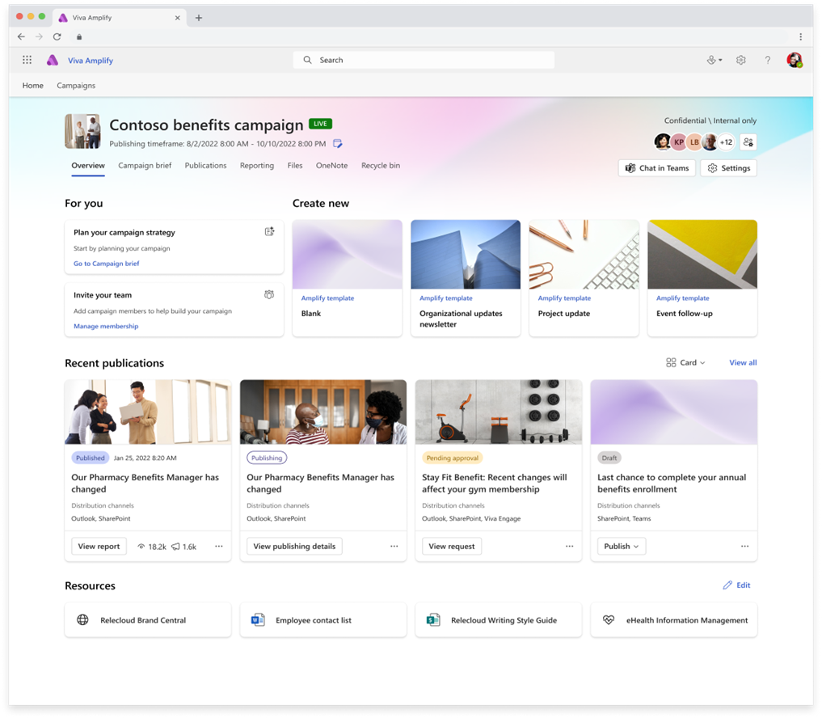
Viva Amplify: Elevate your message with centralized communications
Viva Amplify enables communicators to create, manage, publish, and evaluate campaigns in one place
Guides campaign communicators
to write messages that stick, with writing guidance and reporting
Drives engagement with internal audiences wherever they prefer to consume & interact
Measure effectiveness of your communications and take the next best action to reach your audiences
Generally Available
Notes:
Microsoft Viva Amplify empowers leaders and communicators to elevate their message and energize their people by meeting employees where they are. Using automated publishing, communicators can reach anyone on any app in just a few clicks. Users can create campaigns, enabled with writing guidance and reporting, so that they can be heard, create alignment, and inspire action – all from one place. For employees, Viva Amplify reduces clutter, increasing focus on key messages and driving action on the things that matter.

Slide 24
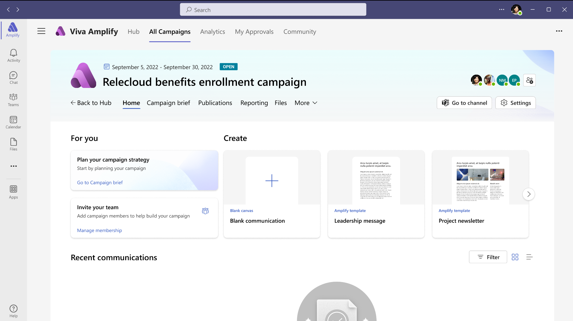
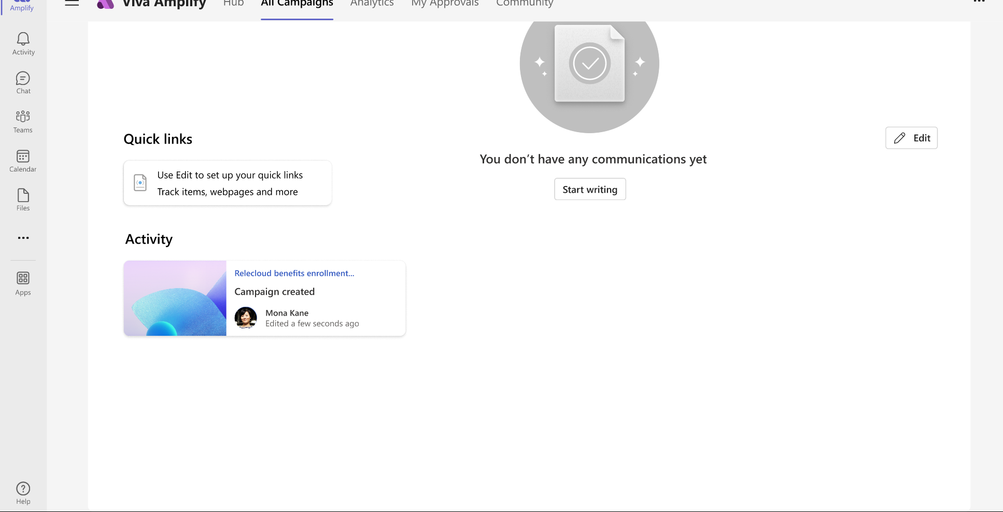

Communicate easier
Provides communicators with a centralized view to create, manage, publish, and evaluate their campaigns in one place
Create campaigns that include multiple communications
Separate message writing from distribution channels by creating comm once
Track reviewers and approvers
Manage multiple campaigns at once
Built as an app on top of SharePoint and can use MIP, permissions, content management features
Notes:
Viva Amplify helps you communicate easier:
Reduce clutter by planning, analyzing, writing, and publishing communications in a single hub
Write messages faster and more effectively with writing guidance and best practices from your organization (companies can upload brand guidelines and authors can get tips from experts in their organization through the community feature).
Save time on publishing by automating campaigns with an editorial calendar – no need to do this manually. [The Forrester TEI study showed a case with a CEO who said Viva Topics freed up 15% of HR and corporate communications teams’ time – this same team is developing Viva Amplify.]
Seamlessly manage approvals with workflows that show who is reviewing messages at which time
Stay focused by managing the lifecycle of various campaigns from one place

Slide 25
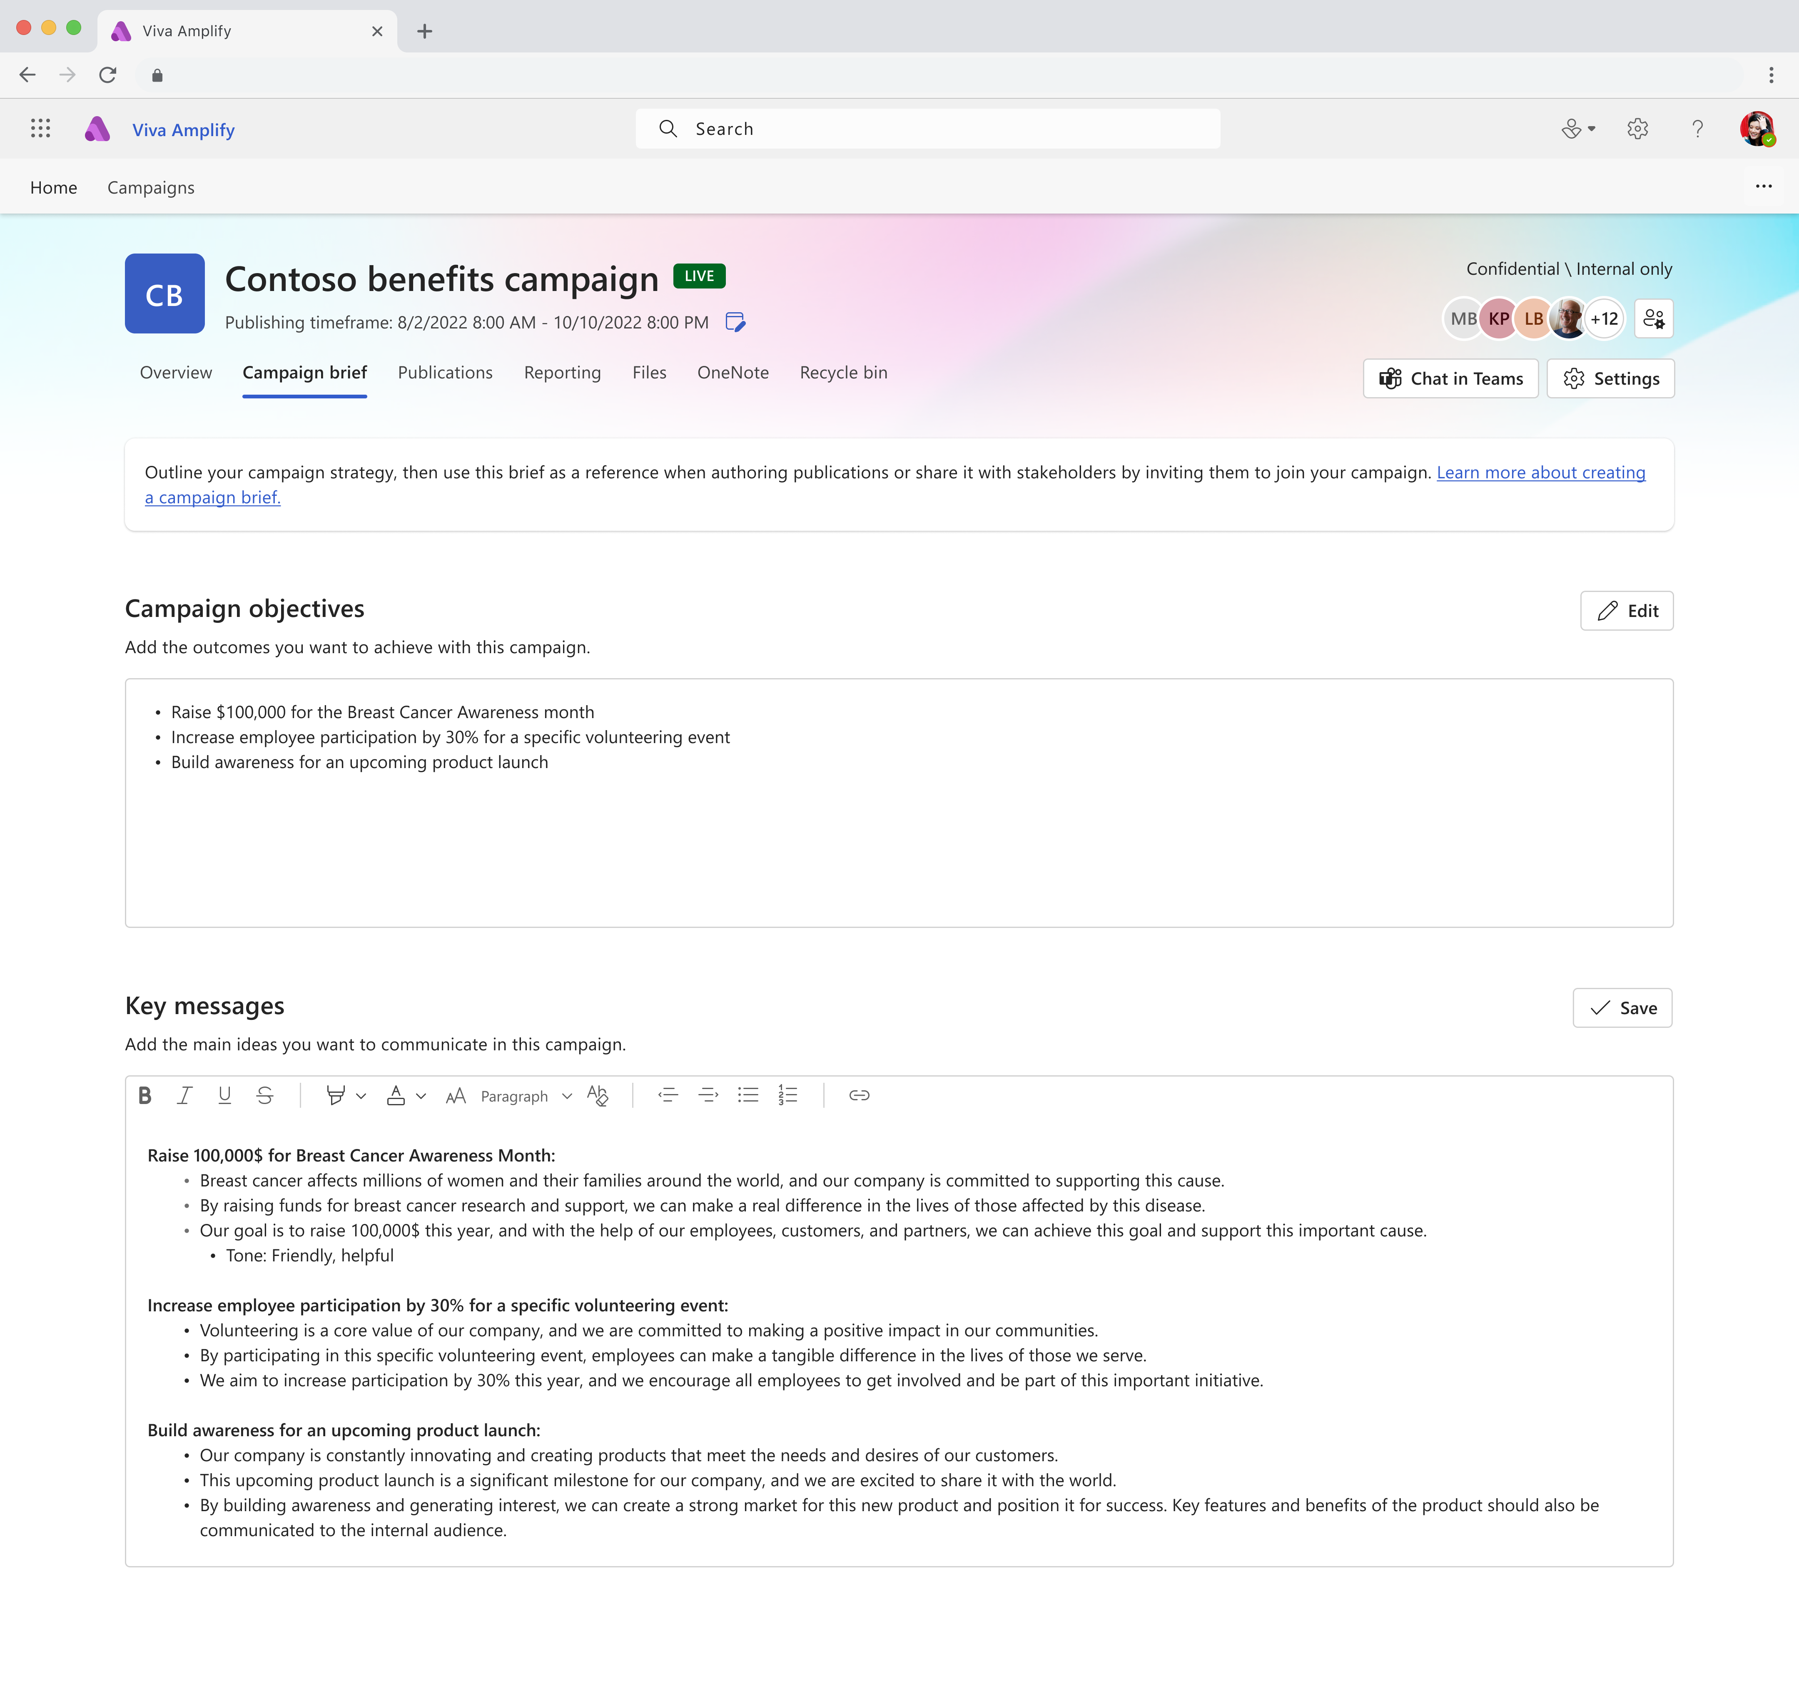
Communicate better
Guides campaign communicators
to write messages that stick, with writing guidance and reporting
Write quality messages that resonate
Get best practices from guidance
Align stakeholders
Set goals and measure success
Use reporting to improve your message
Notes:
Write a message that sticks with writing guidance, reporting, and experts from your organization:
Write quality messages with guidance on tone, style, accessibility, and key points that resonate with your audience
Grow as a communicator by incorporating best practices from experts
Use Campaign Objectives to set goals and measure outcomes so you can make your message a success
Understand how people are interacting with your message and adjust accordingly so that your communications get better and better each time

Slide 26
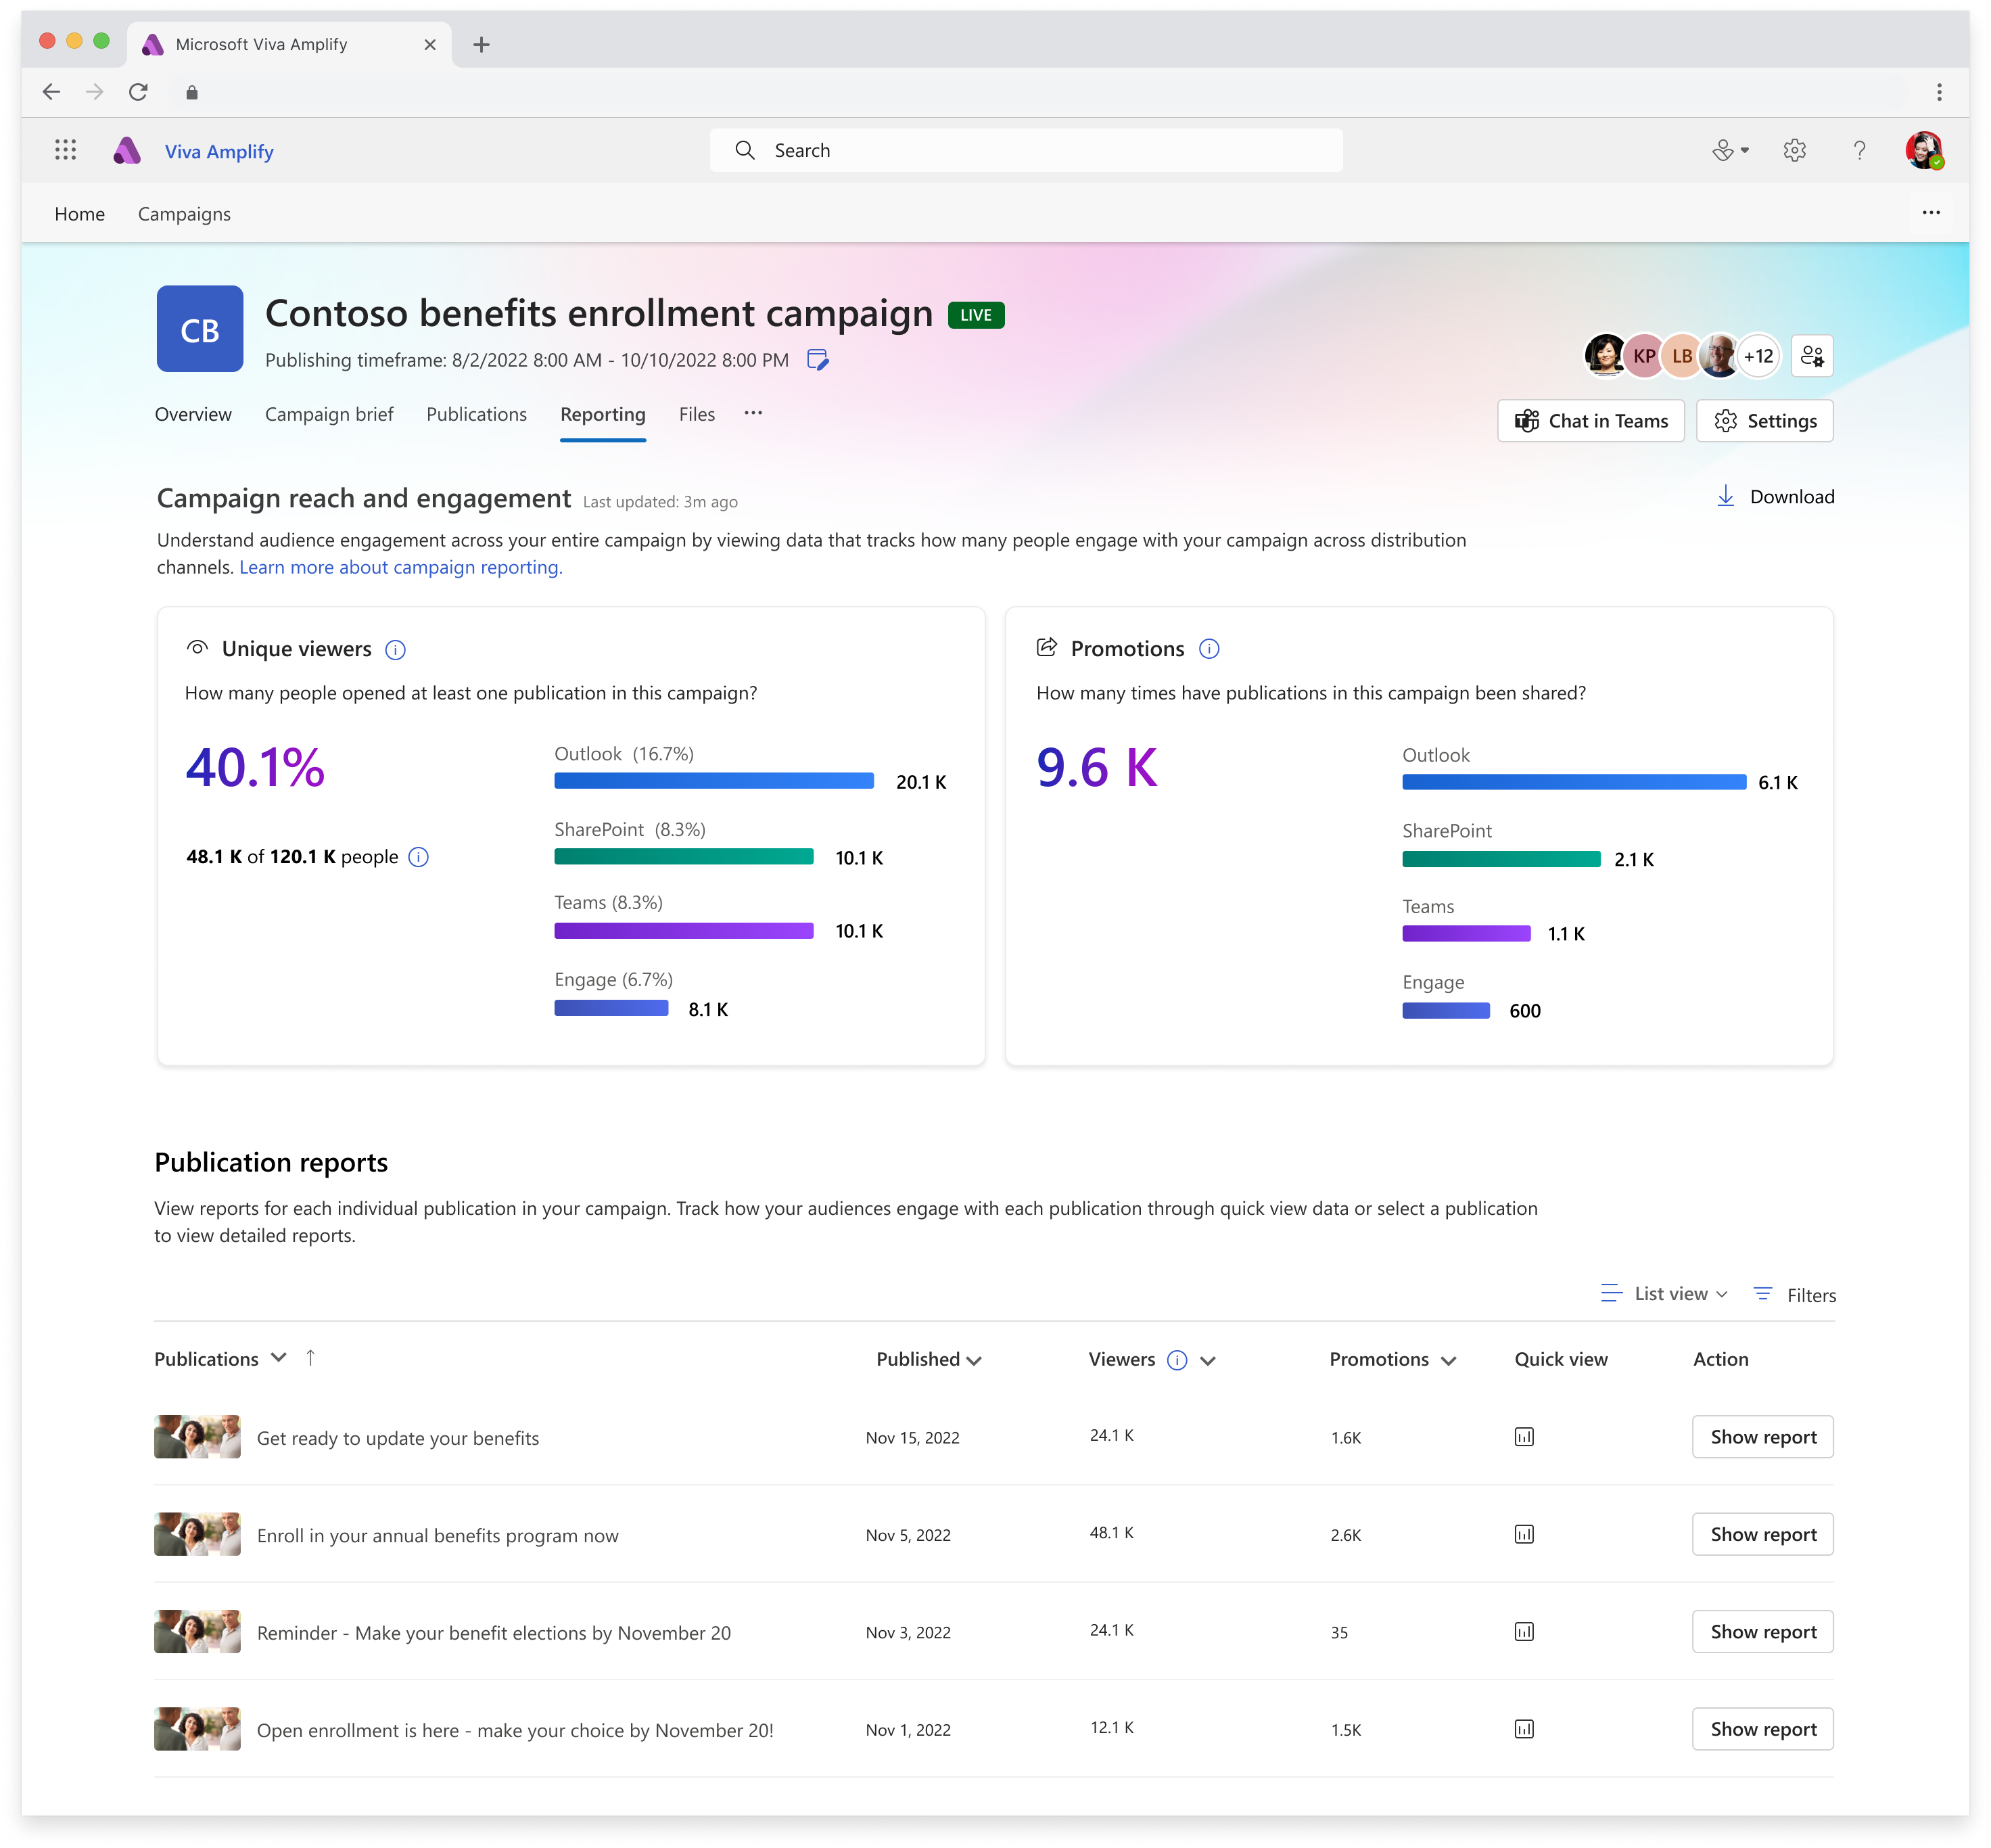
Be heard
Drives engagement with internal audiences by better understanding reach and impact
View aggregate results across campaigns, specific publications, or audiences.
A single dashboard to measure reach across Teams, SharePoint, Mail, Viva Engage
Overlay HR and org data to create reports that measure critical business impact for your organization
Understand which campaigns and publications are most effective in order to replicate success
Notes:
Drive engagement with your message by meeting employees where they are:
Maximize reach to boost critical news, using reporting to understand the optimal channels for publishing
Be heard by easily tailoring communications to specific distribution channels and groups
Grow readership by automatically publishing to multiple apps at the same time
Specific metrics that are measured include % read, # of times promoted (shares, forwards, mentions), and # of interactions (Like + comment). We do not have dwell time in v1 though it may be a consideration for the future.

Slide 27
Scenarios unlocked with SharePoint News

Slide 28
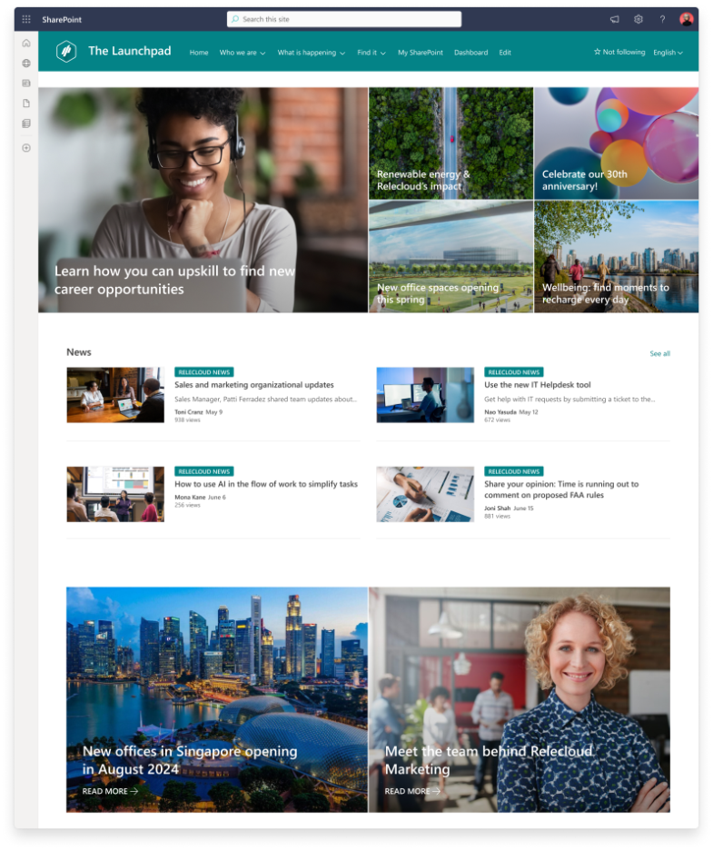
What is SharePoint News?
SharePoint News is a web content authoring and distribution tool for your intranet
Built on SharePoint Pages, it has a familiar and intuitive authoring experience
SharePoint News makes it easy to distribute your intranet content to your audience, wherever they are
Built in analytics and commenting to help you understand how your content is reaching your audience

Slide 29

Common SharePoint News use cases
FAQs
Team News
Trip reports
Newsletters
Facility updates
Project updates
How-to information
Change management
Training tips and tricks
Articles on company culture

Slide 30
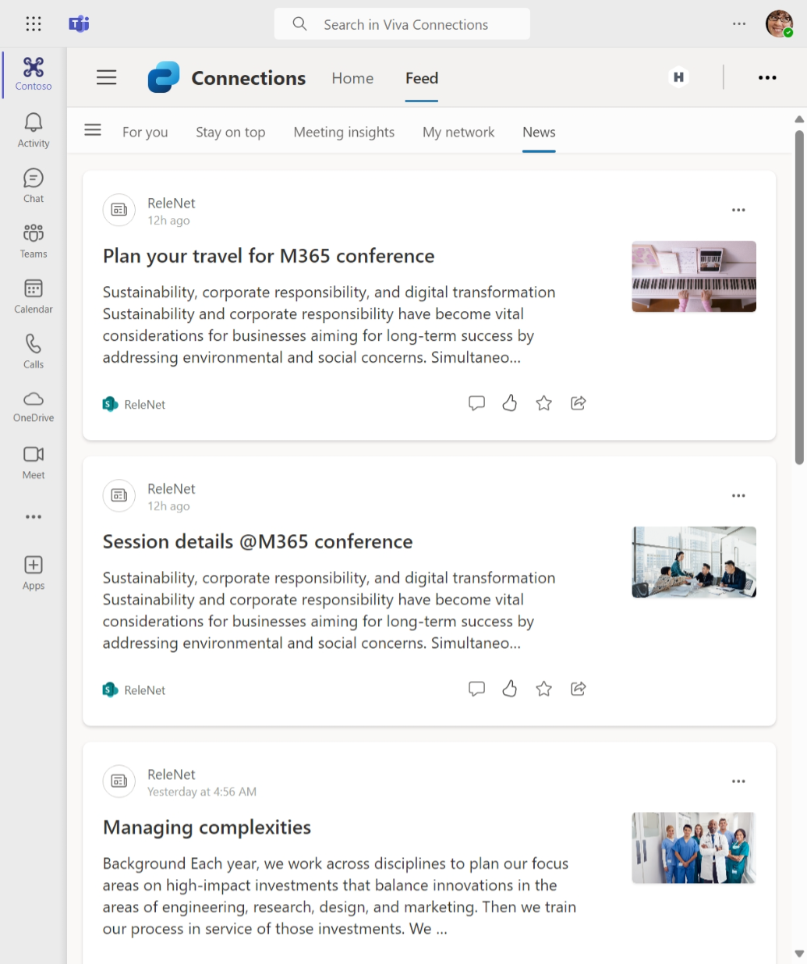
Where is News shown?
SharePoint News posts are published to key OOTB experiences in your intranet, as well as places you choose
These include:
The SharePoint start page and app bar
Team or Communication sites with the News webpart
Hub sites with the News webpart
Viva Connections feed on desktop
Viva Connections mobile app
Email news digests
And now, news posts in Outlook

Slide 31
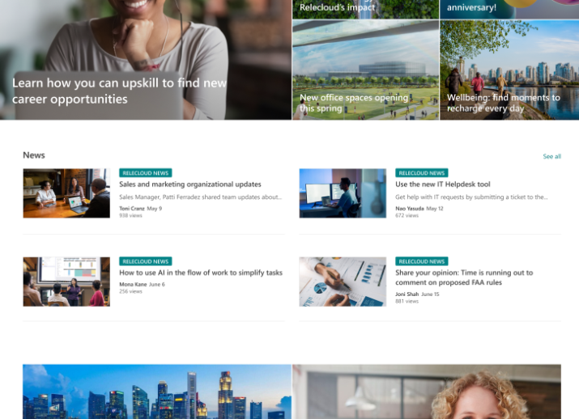
What is an organization news site?
An organization news site is a special designation for a site in your intranet
Organization news sites are intended to be an authoritative source of news content on your intranet
When news from organization news sites are displayed in rollups or feed experiences, they’ll have a special notation for the viewer
You can set up any number of organization news sites in your SharePoint intranet. Home sites are automatically configured as organization news sites.

Slide 32
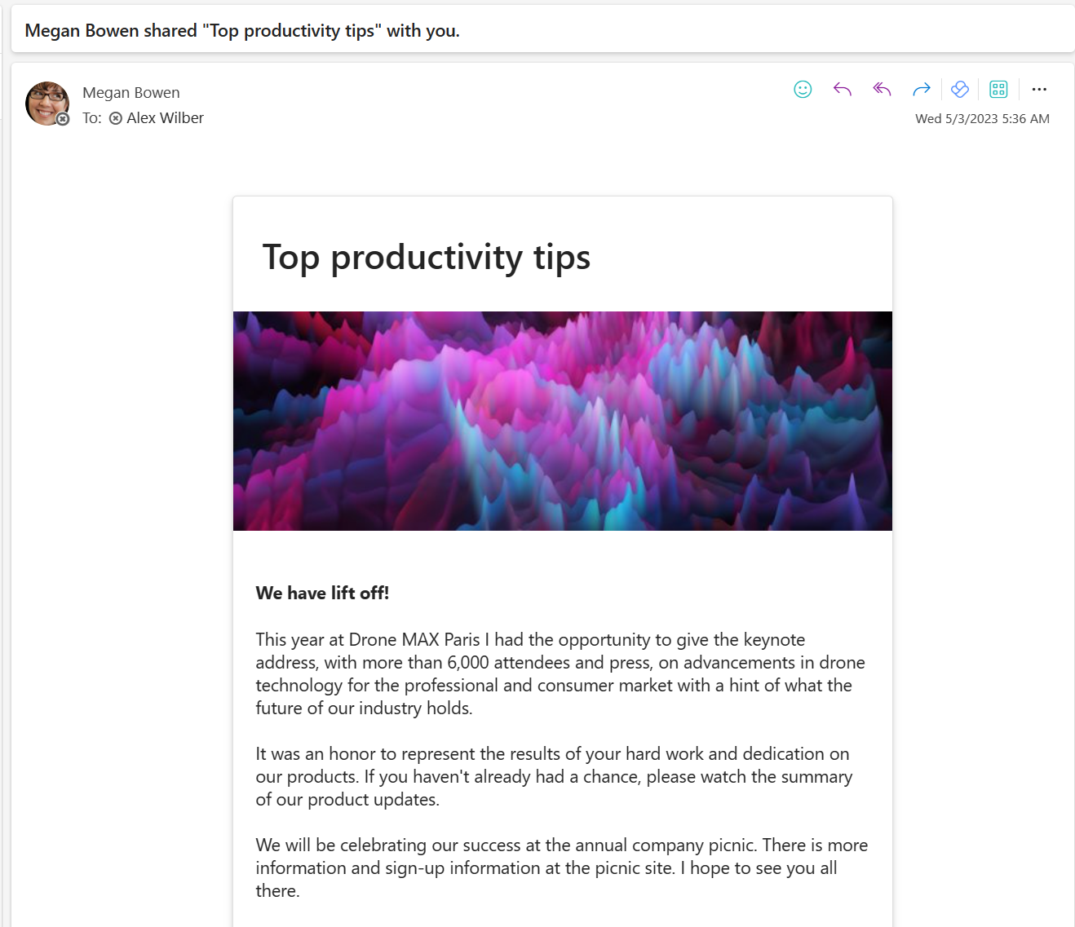
News in Outlook
A key challenge in intranet communication is reach employees where are they are and where they work
Launched last year, News in Outlook is a new capability that sends a fully rendered page in email to maximize readership of intranet news content
The capability includes 6 new news post templates specifically designed to look great in email, with more on the way
Analytics on news posts read in email are captured and presented to the author alongside all other page analytics

Slide 33
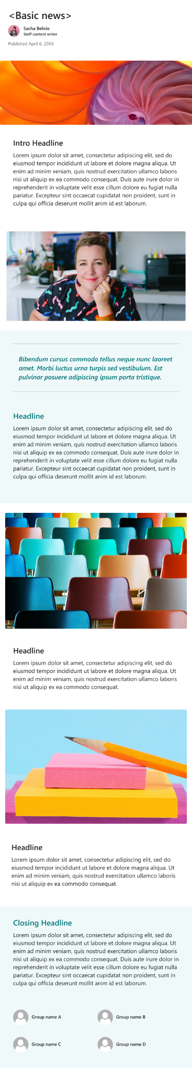
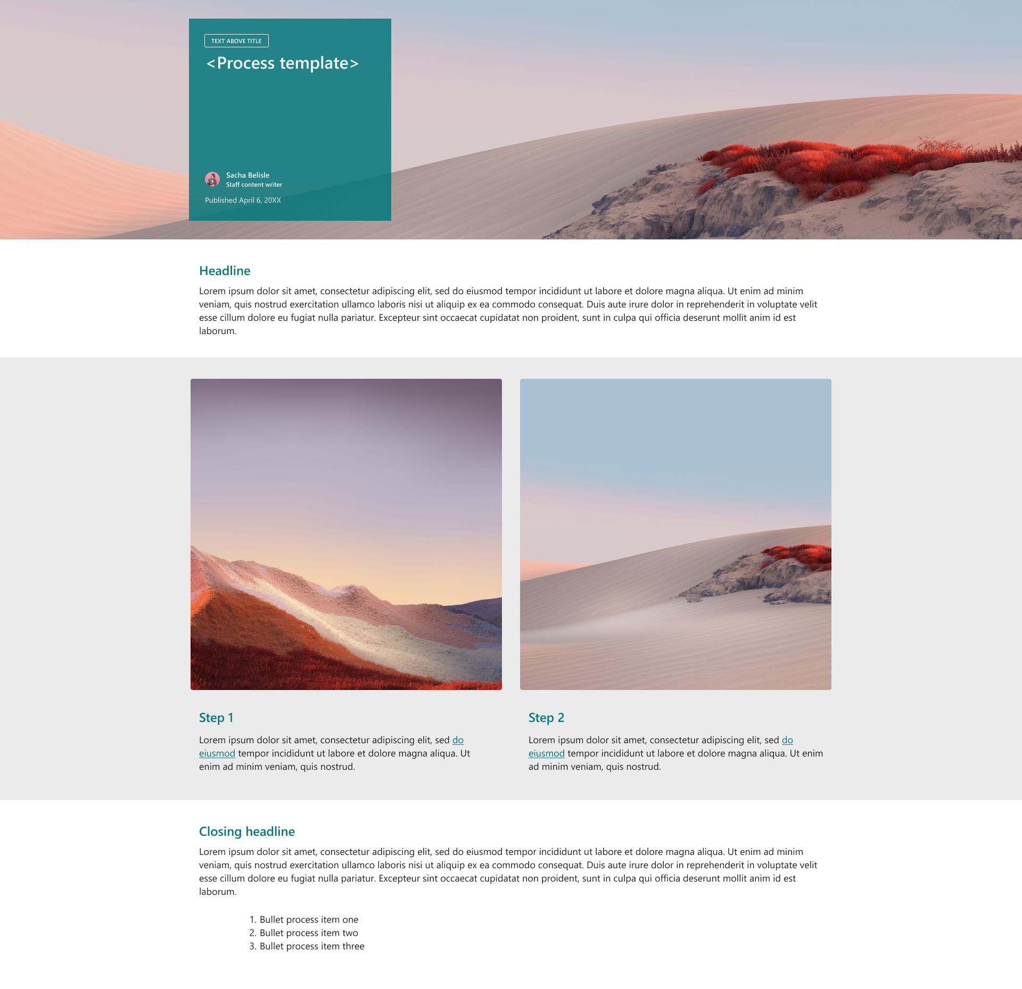


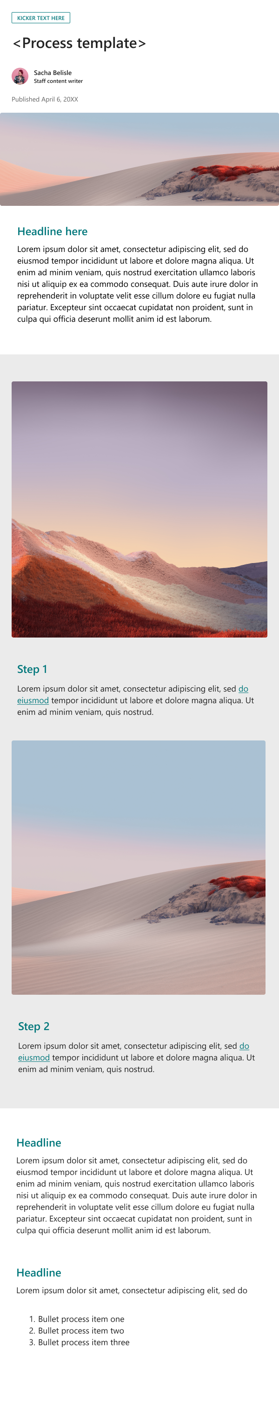

Email-ready templates
Notes:
Explore email-ready templates.

Slide 34
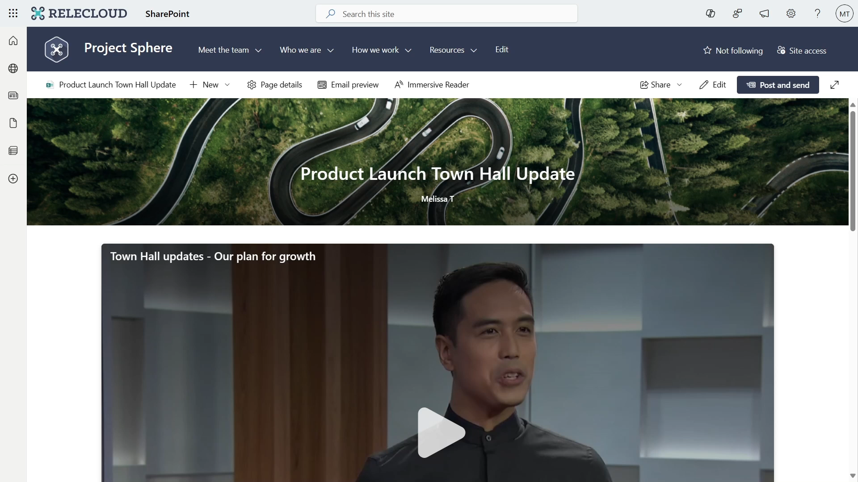
Video pages
Like email-ready templates, video pages are page and news post templates designed for a specific scenario – video
They incorporate the new Microsoft Stream webpart giving you the best video tools in Microsoft 365, right in your news posts
Video pages and news posts can be created directly from the Stream web app
Video pages also integrate with the News in Outlook feature, allowing your video news posts to be viewed directly in Outlook.
Notes:
More and more, video is becoming the way key information is shared within organizations
Recording, editing, and video management tools like Stream and Clipchamp are making it easier and more approachable than ever to produce professional video content
We’ve designed specific news post templates to help you showcase your video content
With the new stream webpart, you can also have the best video playing experience in Microsoft 365 embedded right in your news posts
These pages and news post can be created directly from the video page in Stream, or from the template picker within a site
And, best of all, videos in News posts sent to Outlook will play inline in both OWA AND the Outlook desktop

Slide 35
Tips and best practices for SharePoint News
SharePoint News is intended to be a democratized news content platform for your intranet. Empower creators!
Culture matters. Encourage anyone writing content in email that needs to be durable and findable to try SharePoint News. Change is hard.
Pinning and filtering news content within the News webpart can help your audience see the content that you want them to.
Create a news digest to summarize the latest news for your audience and drive engagement in that content
Target your content with audience targeting. Tag a news post with one or more modern groups and enable targeting on the display webpart. Feeds are automatically targeted
Notes:
Tips and best practices for SharePoint News
SharePoint News is intended to be a democratized news content platform for your intranet. Empower creators!
Culture matters. Encourage anyone writing content in email that needs to be durable and findable to try SharePoint News. Change is hard.
Pinning and filtering news content within the News webpart can help your audience see the content that you want them to.
Create a news digest to summarize the latest news for your audience and drive engagement in that content
Target your content with audience targeting. Tag a news post with one or more modern groups and enable targeting on the display webpart. Feeds are automatically targeted

Slide 36
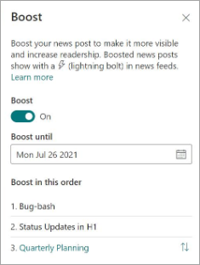
SharePoint News: Boost
SharePoint News content sometimes needs to be visible for longer periods than the feed experience might normally allow
You can set an expiration for a boost, and control the order of news posts that have been boosted
Boosted news will display an icon or label, letting the reader know it’s been boosting for viewership by the organization
Boosted news will display prominently in the Viva Connection Feed and SharePoint app bar and start feeds for up to 4 days

Slide 37
Next steps

Slide 38
Ensure you have durable communications
Communications are subject to freshness, time bound & actionable
Previously, less priority to keeping them other than for examples to use as a basis for future comm
Use your intranet as grounding source for Copilot
Interactive Q&A
Verification of source of communication
Less about ‘views’ on SharePoint, more about re-use

Slide 39

Think of AI as both an audience & amplifier of your communications

Slide 40

Communications demonstrate your corporate culture

Slide 41
Resources
Viva Amplify
Adoption
Microsoft Viva Amplify – Microsoft Adoption
Employee Communication Management | Microsoft Viva Amplify
Viva Amplify technical documentation articles for detailed instructions on technical deployment and admin setup. Introduction to Viva Amplify - Microsoft Support
SharePoint
SharePoint Look Book
SharePoint look book (microsoft.com)
Design Principles, UI Toolkit
SharePoint Design (spdesign.azurewebsites.net)
Notes:
Explore the Microsoft Viva Adoption Hub at https://adoption.microsoft.com/viva

Slide 42
Microsoft Viva

