Slide 1
Get started with
Microsoft 365 Copilot in Teams
Practical examples and how-tos for licensed Microsoft 365 Copilot users
Note: Product user interface shown is current as of May 18, 2026 and is subject to change. Features, functionality, and visual elements may vary over time. Copilot in Teams requires a Microsoft 365 Copilot license.
May 2026

Slide 2
Copilot for meetings
Microsoft 365 Copilot is your everyday AI companion. Copilot is available in Teams Meetings, helping you summarize the meeting, untangle unresolved perspectives, and more.
For more prompt ideas, visit Use Copilot in Microsoft Teams meetings – Microsoft Support.

Slide 3


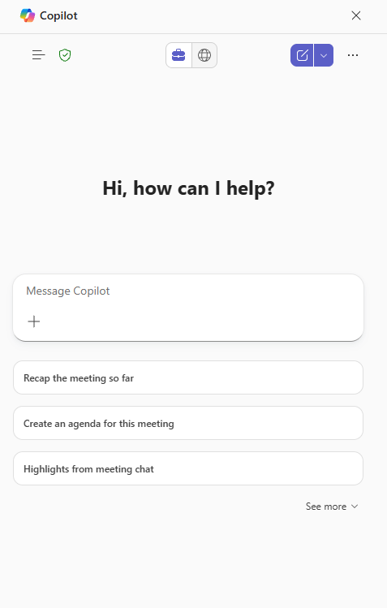
Copilot in Teams Meetings overview
With Copilot in Teams Meetings, you can take advantage of Copilot to help before a meeting, during a meeting, and after a meeting. Some of the capabilities you receive are
Recap a meeting and get action items
Ask questions to Copilot during a meeting to understand context
Have Copilot create an agenda
Here are some ways that you can use Copilot in Teams Meetings
“What decisions were made and who is responsible.”
“Create an agenda for this meeting based on the content in the conversation from the past week.”
“What was discussed in the first 10 minutes of the meeting that
I missed.”​​​​​​​
Notes:
Today we’re going to walk through the new look and feel of Copilot in PowerPoint. What Microsoft did is bring the Copilot Chat interface you are used to using in the Copilot app and Edge browser into the apps for a consistent experience. As a licensed users you can still work with Copilot right in the document, but now you can also search for information across your Microsoft data and the web.

Slide 4
Meeting recap
If transcription was turned on during the meeting, Copilot can also be accessed from the Recap tab in the meeting chat. Open Copilot to see the same conversation history with Copilot as the one accessed from the meeting chat. Read more – Recap in Microsoft Teams

Slide 5
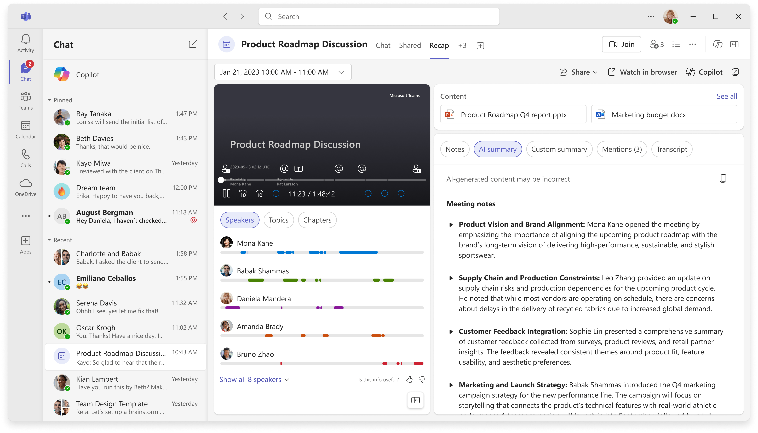
Accessing Meeting Recap
Control options
Short, AI-generated video recap
Recap tab
Select the recap tab to see meeting recap content
Listen to audio recaps of your meetings - Microsoft Support
Share recap with others
Date selection
Select the date you want to recap for recurring meetings
Open the video in a browser
Open the Copilot sidebar to ask questions about the meeting
Video recording
Watch the video
Video info
See information on the video by speaker, topic, or chapter
Content
Open files shared in the chat
Content info
Select the information about the meeting to view
Note: “UI shown as of May 18, 2026. Product features and visuals may change.”

Slide 6
During a meeting
Copilot helps you stay on track by reasoning over the discussion and meeting chat to answer to your questions about the meeting. Select Copilot from the meeting controls to start your private chat with Copilot.

Slide 7


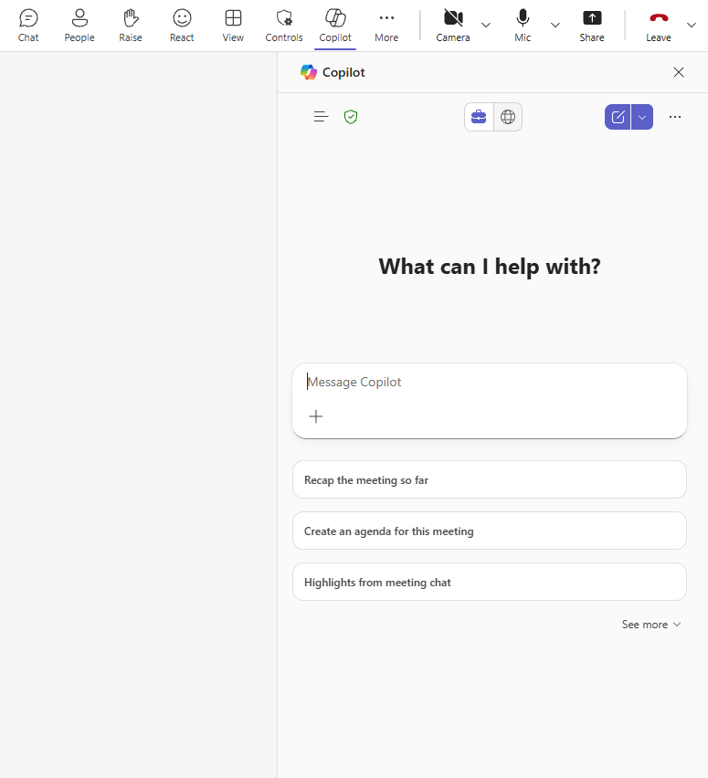
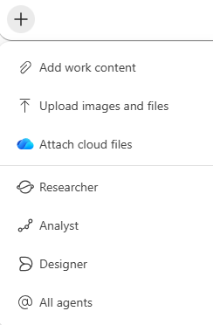
Accessing Meeting Recap
Enterprise data protection
shield – indicates your data is protected
Copilot
Open Copilot Chat from the ribbon
Work/Web – Choose whether you want Copilot to base responses on your Work data or use the web
Navigation panel
Access agents and conversation history
Start a new chat
More options – feedback and controls options
Close Copilot Chat
Prompt Box
Start your chat here
Add content
Add files and images to the prompt
Sample prompts
Suggested prompts that are tailored to your document with option to expand and see more
Note: “UI shown as of May 18, 2026. Product features and visuals may change.”

Slide 8
Including Copilot in your meeting

Slide 9
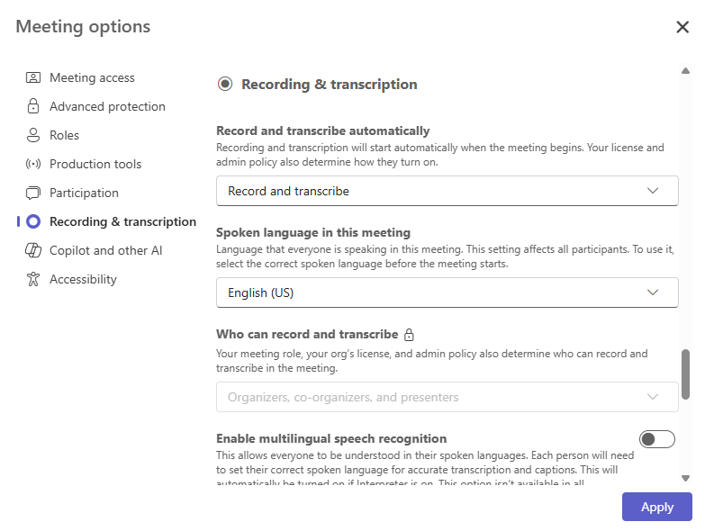
Settings to enable Copilot in a meeting – recording and transcription
Meeting option | Relationship to Copilot
Record and transcribe automatically | If you have permission to transcribe, this will start Copilot automatically. If Copilot is set to “Only during the meeting” and you have permission to transcribe, a transcript will begin and override the “Only during the meeting” setting.
Who can record and transcribe | If Allow Copilot is set to “Only during the meeting”, this can be set to “no one” to prevent anyone from starting a recording or transcript. If Allow Copilot is set to “During and after the meeting”, the “no one” option is unavailable. If Allow Copilot is “Off”, this is set to “no one” and locked.
Note: “UI shown as of May 18, 2026. Product features and visuals may change.”

Slide 10
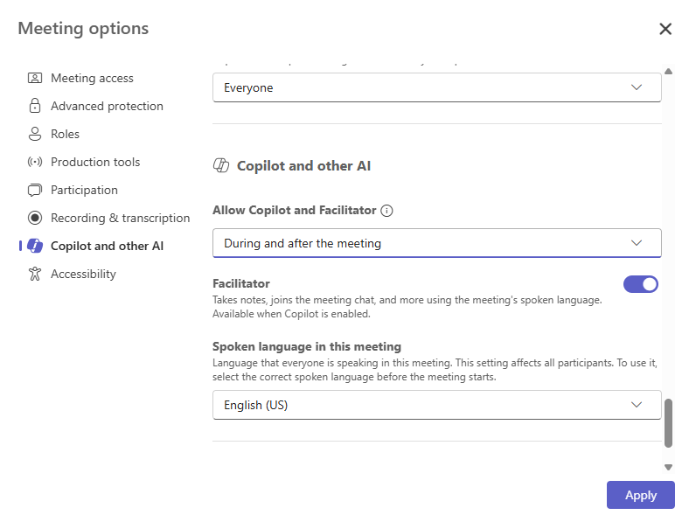
Settings to enable Copilot in a meeting – Allow Copilot and Facilitator
“Allow Copilot” meeting option value | Clicking on Copilot | User notification
Only during the meeting | Starts STT processing for Copilot. STT and Copilot content is not saved after the meeting¹. | Informs users that Copilot and audio processing have been started.
During and after the meeting | Clicking on Copilot prompts the user to start a transcript. A saved transcript is required for Copilot to work. | Informs users that transcript has been started.
Off² | Copilot can’t be selected. Recording and Transcription can’t be started. | N/A
¹Please note that a saved transcript can still be started by any user with permission to transcribe through the Recording and Transcript options.
²Turning off Copilot also disables Recording and Transcription. This is because any saved recording and transcript would be accessible to Copilot outside the meeting.
Note: “UI shown as of May 18, 2026. Product features and visuals may change.”

Slide 11
Scenario #1: I want to use Copilot during and after the meeting
Before the meeting:
  Turn on “Record and transcribe automatically”
  Set the “Allow Copilot” meeting option to “During and after the meeting”
During the meeting:
  You will get a notification that the transcript has been started. A red dot will appear on the top of your meeting window.
  If transcript isn’t started, it can easily be started by clicking on the Copilot icon.
To recap a meeting using AI, we recommend turning on recording to capture visual information shared during the meeting and give participants a holistic, interactive recap experience. If you opt not to record the meeting, you will still need to turn on the transcript. Transcription lets you revisit and verify Copilot-generated content when it’s most convenient, including Copilot notes and your previous conversation with Copilot. It also enables you to continue asking questions after the meeting is over. It’s easy to set up your meeting to record and transcribe automatically as soon as it starts.
After the meeting:
  After the meeting, you can ask Copilot questions about the meeting in the meeting chat if a transcript exists for your meeting. In recurring meetings, a transcript needs to exist for the most recent occurrence of the meeting.
  Go to the Recap tab to view Copilot Notes, the recording, transcript, and
  more. You can continue chatting with Copilot on Recap as long as the transcript is saved.
  Organizers can view a detailed attendance report on the
  “Attendance Report” tab.
  You can also use the M365 Copilot chat to ask about your meeting.

Slide 12
Scenario #2: I want to use Copilot during my meeting without keeping anything afterward
Before the meeting:
  Set “Allow Copilot” to “Only during the meeting”
  Set “Who can record and transcribe” to no one. This will prevent all participants from starting any transcript or recording.
  Set “Restrict copying or forwarding of meeting content” to “On” to prevent any chats from being saved after the meeting.
During the meeting:
  Copilot will only start its temporary speech-to-text capture when a participant clicks on the Copilot icon. Ensure that someone clicks on Copilot as soon as the meeting starts to ensure that it can answer questions about the entire meeting. Once it starts, all users will get a notification that Copilot has been started.
For meetings where confidential or sensitive content is discussed, or for tenants that don’t allow transcription, Copilot can be used “Only during the meeting”. When this setting is used, no Copilot history or STT processing will be saved, and recap artifacts such as AI Notes will not be generated. To prevent all participants from recording or transcribing, use the “Who can record and transcribe” option.

Slide 13
Scenario #3: I want Copilot to recognize me when I am speaking in a Teams meeting room
Before the meeting:
  Set up a Voice Profile so you can be identified in the transcript or speech-to-text processing.
  Learn more about voice profiles: Use Microsoft Teams Intelligent Speakers to identify in-room participants in a meeting transcription – Microsoft Support.
During the meeting:
  Verify that transcription or Copilot “Only during the meeting” has been started.
  Use your laptop, phone, or tablet to ask Copilot questions.
As a participant in a Teams meeting room, you will want to ensure that you are identifiable in Copilot’s responses and the transcript. You can set up a Voice Profile so that you are represented in the transcript when you are speaking in a meeting room. Additionally, you’ll want to verify that Copilot has been started for everyone.

Slide 14
Support articles
Copilot for Teams meetings support:
  Catch up on meetings with Microsoft 365 Copilot in Teams –
  Microsoft Support
  Use Copilot without transcribing or recording a Teams meeting or call – Microsoft Support
  Interpreter in Microsoft Teams meetings and calls – Microsoft Support
  Listen to audio recaps of your meetings – Microsoft Support
Recap in Microsoft Teams

Slide 15
Chat in Teams

Slide 16
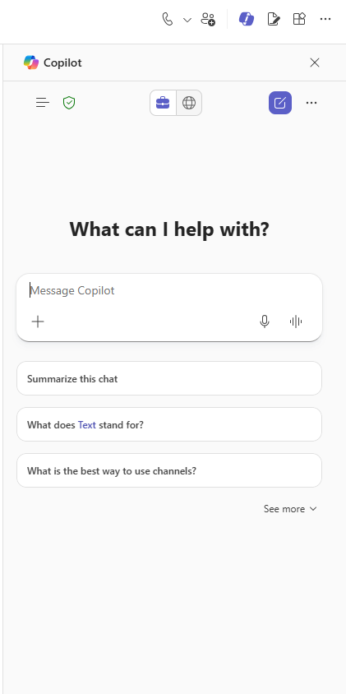
Copilot in Teams Chat overview
With Copilot in Teams Chat, you can get up to speed on conversations without having to scroll through long threads.
Ask questions about the chat
Summarize the conversation
Identify decisions and action items
Here are some ways that you can use Copilot in Teams Chat
Summarize what I’ve missed.
What were the key takeaways from last month?
What did [a member of the chat] say?
What links were shared?
Note: “UI shown as of May 18, 2026. Product features and visuals may change.”
Notes:
Today we’re going to walk through the new look and feel of Copilot in PowerPoint. What Microsoft did is bring the Copilot Chat interface you are used to using in the Copilot app and Edge browser into the apps for a consistent experience. As a licensed users you can still work with Copilot right in the document, but now you can also search for information across your Microsoft data and the web.

Slide 17
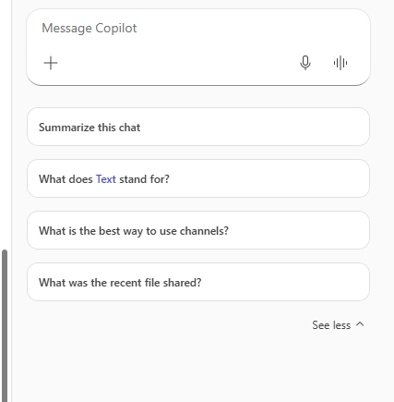
Getting started
Open the chat panel
You must be in a 1:1 or group chat, to access the private Copilot side panel.
Explore Prompt suggestions
Chat Copilot provides suggested prompts for you to use to explore the power
of Copilot.
Note: “UI shown as of May 18, 2026. Product features and visuals may change.”

Slide 18
Try it out
Use Case | Prompt
Catch up: Understand a chat without scrolling | Try the prompt: Summarize what I’ve missed in this chat and highlight key decisions.
Clarify: Extract action items to improve execution | Try the prompt: What are the action items from this conversation, and who owns each?”
Decide: Surface decisions to help with summaries | Try the prompt: What are the action items from this conversation, and who owns each?”
Act: Move conversations forward and drive ideation | Try the prompt: What follow-up questions or next steps should we take based on this conversation?

Slide 19
Support articles
Copilot for Teams meetings support:
  Start a conversation with Microsoft 365 Copilot chat in Teams – Microsoft Support
  Rewrite and adjust your messages with Copilot in Microsoft Teams – Microsoft Support
  How to use Microsoft 365 Copilot in Teams chats and channels – Microsoft Support
  How to use Microsoft 365 Copilot in Teams group chats – Microsoft Support
  Summarize shared files in Teams chats – Microsoft Support
  Find and add Copilot agents to group chats in Microsoft Teams – Microsoft Support
  Get started with Channel Agent for Teams channels – Microsoft Support

