Slide 1
Document purpose
The purpose of this document is to guide you on deploying Copilot Analytics and to provide an overview of the controls and safeguards in place to help ensure a successful implementation.
The content here can help you:
  Understand various stakeholders (privacy, security, compliance) you may need to align with and their key concerns
  Help you set expectations and also understand their expectations
  Build trust by creating transparency
Every company is different. Tailor this content to your organization's specific needs and circumstances.

Slide 2
Copilot Analytics
Accelerating risk and compliance discussions guide
Feb 2025
© Copyright Microsoft Corporation. All rights reserved.

Slide 3
Copilot Analytics: designed for safe deployment
Designed to thwart monitoring: Includes built-in controls like deidentification and differential privacy, enabling you to focus on Copilot adoption and impact, while preventing monitoring individual employees.
Aggregated data only in Copilot dashboards: Dashboards display data in aggregates, ensuring privacy through differential privacy techniques.
Upholds data privacy standards: Fully compliant with personal data processing guidelines and terms of service.
You are in control: Provides flexibility to exclude specific employees or geographies from analysis.
Enable sophisticated analysis using advanced insights: Access controls, data delimiting via partitions, keyword and domain suppression provides additional controls for advanced scenarios.
Notes:
Let’s first start with why it is safe to deploy Copilot Analytics
Privacy was a core design principle. We want customers to get meaningful data without compromising user privacy. We achieve this through deidentification, differential privacy and other capabilities.
Our dashboards are built to display only aggregated data, never individual usage. By leveraging differential privacy techniques, we ensure that no single user’s data can be isolated or identified.
This is part of the secure and trusted M365 ecosystem. You can confidently use the insights knowing that all data handling aligns with established privacy and security standards
You have the flexibility to tailor analysis based on your needs. Whether it's excluding specific employees, teams, or even entire geographies, you remain in control of how data is used and interpreted.
And we also kept in mind that if you have ambitions to perform deep analytics, then we equip you with further advanced controls like applying analysis boundaries on data and suppressing certain results.

Slide 4
How to safely deploy Copilot Analytics
Business sponsor / CIO
HR/HRIT
Info sec/house security
Leads the analysis
for the company
Supports admin activities such as org data upload
Safe and compliant
rollout of new tech
Privacy office
Legal/employment law
Works council/employee relations board
Protection of employee privacy and confidentiality
Project does not break employment policies
Understanding collection and use of employee data
Note that you will also engage with Microsoft 365 admin to roll out the features
Notes:
The first step in this journey involves getting the necessary approvals to roll out Copilot. Here are some of the roles you will likely work with.
Business sponsor – typically CIO or Department Head who wants to understand Copilot Analytics adoption and impact
HR / HRIT – To gain full benefits you will need periodic support in the form of uploading HR data. This is typically housed in HR given data sensitivity
Info sec – As you are rolling this out for the first time, some security teams might have questions around compliance and audit, storage and retention.
Privacy office – This group will determine the disclosures necessary, how the data that we are using aligns with existing company policies, what tweaks might be necessary etc.
Employment Law – This group might be in the same division as DPO. They take into account things like what has the employee signed as part of their agreement etc.
Works council – transparency and use of employee data

Slide 5
When to engage the stakeholders
Business case
and sponsorship
How are employees using Copilot?
Which groups are using it with high intensity?
What impact are we seeing with usage?
Security and compliance
Is the tech GDPR compliant?
How long is
the data retained?
Is the data
brought to us?
Data use
and privacy
What data will be used?
What will the analysis
be used for?
Who has access to it?
How do we preserve confidentiality?
Works Council (WC)/EU roll out
How do we roll this out
in countries with WC?
What are the risks
and benefits of
rolling this tech?
CIO / Business
House sec
/info sec
Privacy office
Works council
HRIT
Legal/
employment law
Notes:
Given the different needs of these groups, engagement with the groups come at different times. So the different stages are
You want to have alignment on Biz case/sponsorship with questions like who is using Copilot, how are they using it, what’s changing with Copilot usage, you need partnership with Business and potentially with HRIT
For architecture and compliance related matters, where there are questions around GDPR, SOC2 compliance, where is the data stored etc. you will work with HSEC
For Data Use and Privacy, and Confidentiality – where you are answering what data is used, what will it be used for, who has access – it will be the DPO
Works council – rolling out in EU, risks etc. WC
Regardless of who you engage with, it is helpful to articulate what is the product, what are the different surfaces, what value does it add.

Slide 6
Table of contents
Business case
Controls
Product overview
How it works
How we plan to use Copilot Analytics
Clarity of objectives
Rollout plan
Security and compliance
Controls
Architecture
Compliance
Data handling and storage
Microsoft 365 Trust and Shared Responsibility model
Data use and privacy
Controls
Data sources
Data output
Usage
Whose data to process?
Preserving confidentiality
Access controls and governance
Works council
Controls
Transparency
Stakeholders
Risks and benefits
Mitigation
Notes:
The rest of the deck goes into material that will fit into the categories we laid out earlier. We will cover the key elements, and controls that are available either in the form of system enforcements or with the administrator.

Slide 7
Business case and overview
What is Copilot Analytics?
How does Microsoft Viva Insights power Copilot Analytics?

Slide 8






Copilot is a key part of how people work…
Copilot Chat
Schedule
Discover
Share
Ask
Actions
Analyze
Meet
Understand
Intelligent Recap
Create
Summarize
Draft
Rewrite
Notes:
If you think of a typical day, you are discovering new things, you are meeting people, you are creating content, you are learning and understanding, and you are sharing information.
Copilot is infused into every one of these actions.
Copilot is a thought partner, it is an assistant that helps you keep track of action items and brings you up to speed; it is how we create and consume information. All these activities leave a digital footprint.

Slide 9





…and analytics tell you how it is influencing work and outcomes
60
Deals won with Copilot usage
Copilot actions per person per week
14
21
7
3
10
5
Meeting recap
Search
Create a draft
Create a presentation
Summarize
Format
Meeting actions
Summarize
Summarize
Coaching
Formula
Notes:
By analyzing the event activity and aggregating it over time, organizations can understand how work itself is changing.
We can then further unpack it by various surfaces and even actions. Ultimately, it will help you think about the impact Copilot is having on your organization.

Slide 10




How it works
Microsoft 365 data
Copilot data
Business context
Impact and change
Start with aggregated data from everyday work in collaboration tools
[sender, receiver, time, duration]
Usage activity data across Microsoft 365 surfaces
[actions taken, prompts]
Overlay of org descriptors
and business outcomes reveals patterns of success
[Org, Region]
Understand Copilot ROI, where it is having an impact, how is the business changing
Robust governance and controls
Notes:
In order to produce these insights, we use
Microsoft 365 contains the largest graph of human activity and interactions at work ever created. When people use collaboration tools, like chat, email and calendar, they leave behind digital footprints that are captured in the Microsoft Graph. The beautiful thing is this data is produced as a natural by-product of the work people do every day. It doesn’t require people to do anything extra or differently.
In addition to M365 graph, we also have Copilot event activity. Think of all the actions you take when you invoke Copilot across M365 surfaces.
Combining this information with organizational context and other relevant data, such as role, function, employee engagement scores, outcome data, organizations can understand how Copilot is influencing work.

Slide 11
Why it is important to use Copilot Analytics?
It deepens your understanding of the change and value.
How are we using Copilot?
What’s the impact of Copilot?
How work is changing with Copilot?
How many are using it?
How often are they using it?
What are they using it for?
What KPIs have changed with Copilot usage?
Are we seeing a level of usage that can drive business impact?
What is the ROI?
How is collaboration changing with Copilot?
What’s the Employee Experience impact of Copilot?
Are they happy with Copilot?
Objectives
Active users
Copilot actions across surfaces
Prompt types
Copilot actions across surface
Prompt types
Collaboration hours
Networks
Copilot actions
Example
metrics
Example
org data
Organization
Region
Cases resolved
Leads created
Quota attainment
Engagement scores
Organization
Notes:
"Understanding how Copilot is being used in your organization is critical for unlocking its full value. Copilot Analytics helps you deepen your understanding of the change and value it brings
You might first start with:
1. Basics of adoption:
How many people are using it?
How often are they using it?
And what tasks are they leveraging Copilot for?
Metrics like active users, Copilot actions across various surfaces, and prompt types give us actionable insights into how Copilot fits into daily workflows. These metrics can be segmented by organization or region for tailored analysis."
Next, you might be curious about
2. What’s the impact of Copilot?
Which KPIs are being influenced by Copilot usage?
Are we seeing a level of usage that drives measurable business outcomes?
And, critically, what is the ROI?
Depending on your function and role, you might bring outcome data such as leads created, or quota attainment to help tie Copilot's impact to business success.
And finally, as Copilot will likely change work itself. Analytics can give you early signals on
How is collaboration evolving?
What’s the employee experience impact?
And are users happy with Copilot?
Here, we examine metrics like collaboration hours, network activity, and Copilot actions, along with engagement scores. This gives us a clearer picture of how Copilot is reshaping the work environment and improving team dynamics."

Slide 12
Potential actions from the analysis
Identify training opportunities: Pinpoint where to focus enablement efforts to drive adoption.
Optimize rollout plans: Shape rollout and communication strategies for maximum effectiveness.
Identify best practices for change management: Gain insight into employee experience and manage change.
Reimagine workflows: Highlight groups or functions ripe for process innovation.
Maximize return on investment: Unlock the full potential of Copilot usage across your organization and improve ROI.
Notes:
Using Copilot analytics allows us to go beyond simple adoption metrics and provides actionable insights into critical areas for maximizing its impact
Identify Training Opportunities
"By analyzing usage patterns, we can pinpoint where to focus our enablement efforts to drive adoption. This ensures that training is targeted and addresses the most significant gaps."
Optimize Rollout Plans
“Data might guide you that some teams have a more urgent need than others. It can also shape communications around the roll out based on team readiness, usage trends, and feedback."
Identify Best Practices for Change Management
"Understanding the employee experience with Copilot gives us insights into what’s working and where adjustments are needed. This helps us manage change and share best practices across teams."
Reimagine Workflows
"Analytics highlight specific groups or functions where there’s potential for process innovation. These insights enable us to redesign workflows and enhance efficiency."
Maximize Return on Investment
"Ultimately, these insights help unlock the full potential of Copilot usage, ensuring broad adoption and improved ROI across the organization."

Slide 13
Personas and how they interact with Copilot Analytics
 | What do they get access to? | How do they get access? | What do they use it for?
Senior leader (Leaders in top 3 levels of the org) | Copilot Dashboard (Teams/web) | Auto enabled* | Understand macro trends
Global Admins | Copilot Dashboard (Teams/web) | Auto enabled | Understand usage patterns
Delegates | Copilot Dashboard (Teams/web) | Granted by an existing user (e.g., senior leader) | Operationalize priorities of a leader
Specific users | Copilot Dashboard (Teams/web) | Granted by Global Admins | Understand macro trends
Analysts | Advanced insights (web) | Granted by Global Admins | Advanced scenarios and deep analytics
* Auto-enablement is for tenants that have at least 2,500 users. Auto-enablement for leaders can be disabled by admins.
Additionally, Global Admins can also enable other features of Viva Insights, such as Personal Insights and Manager Insights. These do not present Copilot information.
Notes:
To ensure Copilot Analytics delivers meaningful value, it’s important to understand the different personas that interact with the platform, what access they have, how they obtain it, and what they use it for. Let me walk you through the key personas:"
Senior Leaders
"Senior leaders, typically within the top three levels of the organization, have automatic access to the Copilot Dashboard across Teams and the web. Their primary focus is on understanding macro trends to inform strategic decisions."
Global Admins
"Global Admins also have auto-enabled access to the Copilot Dashboard. They play a dual role—understanding macro trends and enabling access for other personas across the organization."
Delegates
"Delegates, such as assistants or team members acting on behalf of a leader, are granted access to the Copilot Dashboard by an existing user, like a senior leader. Their role is to help operationalize the leader’s priorities."
Specific Users
"Specific users, including department heads or project leaders, gain access to the Copilot Dashboard through permissions granted by global admins. They use it to gain insights into macro trends relevant to their specific areas."
Analysts
"Analysts are provided access to the advanced insights capabilities through the web, also granted by global admins. They focus on deep analytics and advanced scenarios, offering granular insights to support decision-making."

Slide 14
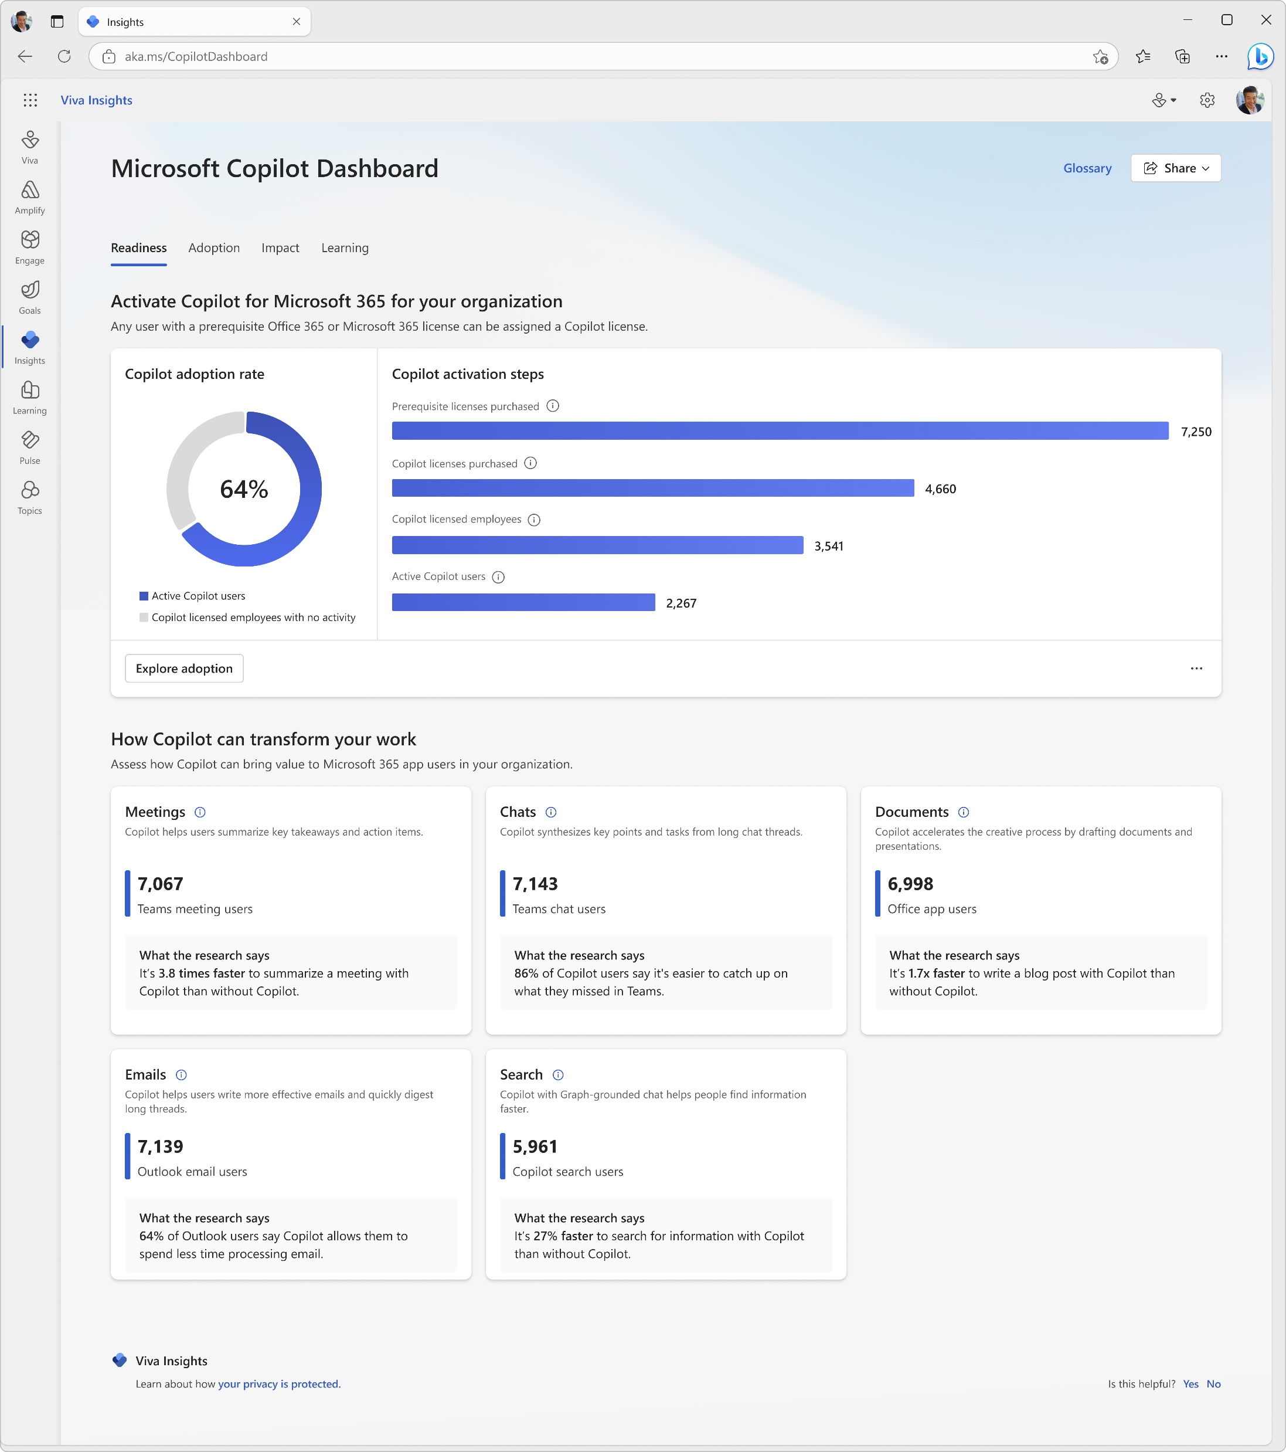
Senior leaders and Global Admins
Copilot Dashboard for Senior leaders and Global Admins
Auto assignment
User is in the top 3 levels of the company
Has a significant number of people reporting to them
OR
Is a Global Admin (Microsoft 365 admin) or AI admin
Note: Auto assignment can be disabled by the Global Admin
Determining access to senior leaders
Notes:
You may be wondering how and when each of these roles start experiencing these features. It’s natural to have questions like whether employees will be startled by new features popping up.
First of all, there are 2 roles for whom Copilot Dashboards are auto enabled.
Very senior leader, with an emphasis on very, and Global Admins.
If you are in the top 3 levels of a company and have a significant number of people reporting to you, CPD is auto enabled for you. But a Global Admin can disable auto assignment capability.

Slide 15
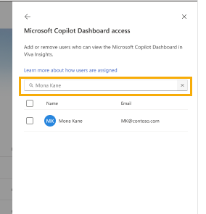
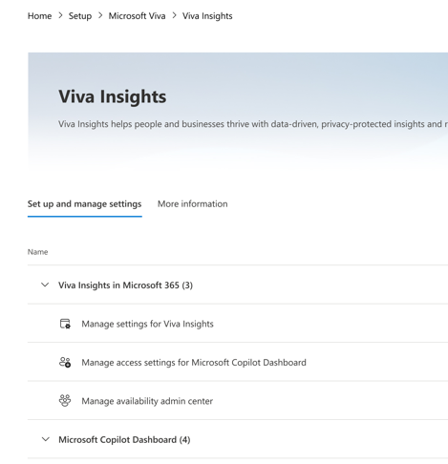
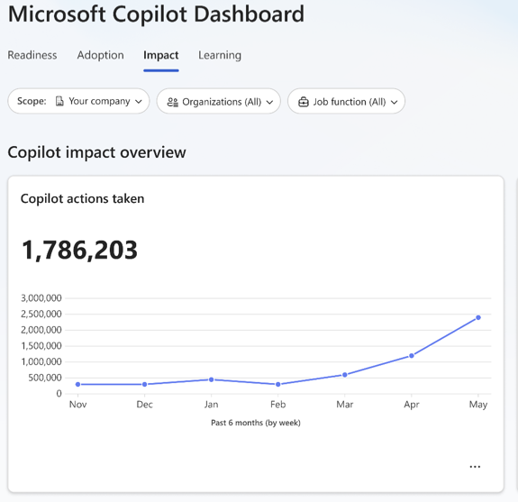
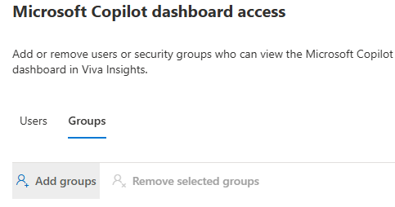
Specific users
Global Admin
Copilot Dashboard for enabled users
Search for the users
Select from the list
Click Add
Copilot Dashboard access can be granted for security groups, too.
Navigate to Home -> Setup – Microsoft Viva – Viva Insights
Assigning access to specific users
Notes:
Global Admin can also enable access to specific users by searching and adding from the list.

Slide 16
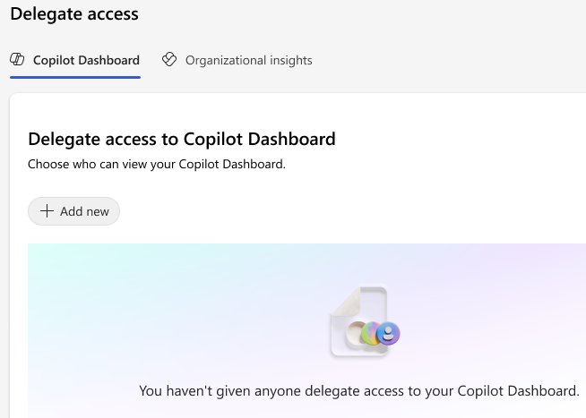
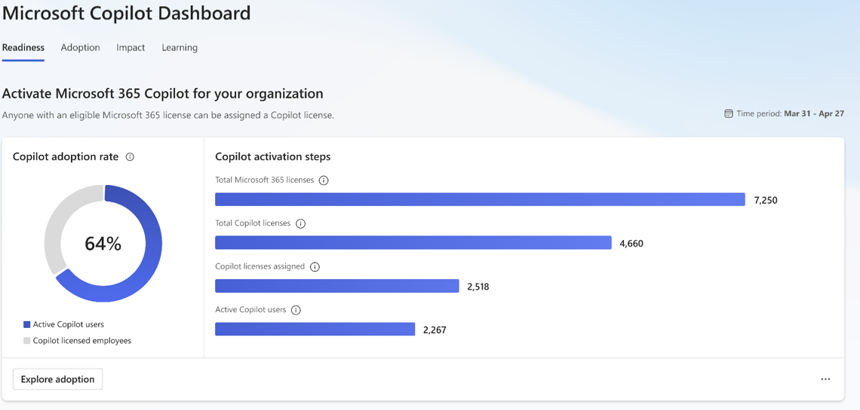
Delegates
Users with access to Copilot Dashboard
Copilot Dashboard for the delegate
Existing users: Viva Insights/Copilot Analytics app -> Settings (Ellipsis on top right) -> Delegate access -> Add new
Delegate feature can be disabled by Admins at the tenant level.
Admins can use audit logs to identify which users have access to Viva Insights through delegation.
Users with delegated access have absolutely the same view as the person delegated the access, while this view can be be different if access is provided by GA
Delegating access and Learn about audit logs
Notes:
And any existing user can delegate access to another user by going to Settings and using the delegate access option. The user with delegate access will see the same view as the person who granted delegate access

Slide 17
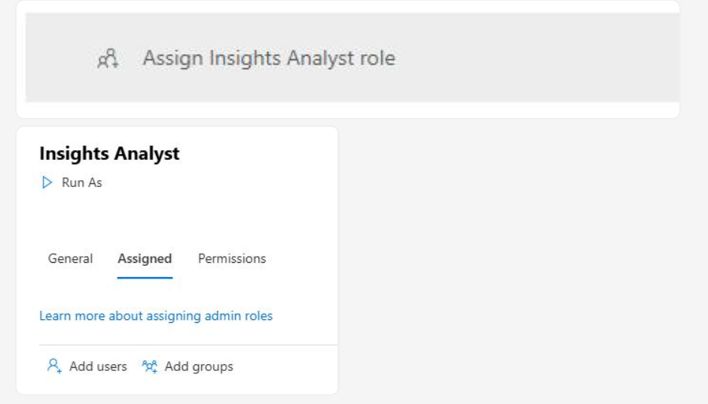
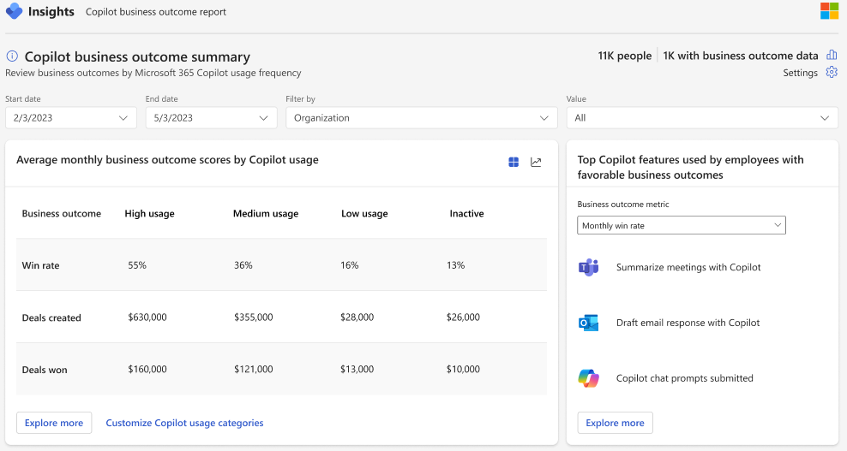
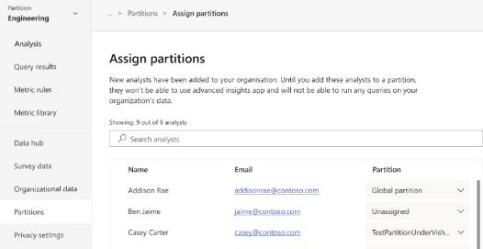
Analysts
Copilot Power BI reports for analysts
Microsoft 365 admin assigns analysts
CSV reports
Viva Insights admin assigns partition(s)*
Separate URI for advanced capabilities.
Library of pre-configured PBI reports
Querying capabilities to extract csv output
*Necessary if partitions have been created to delimit the visibility of data set. If no partitions are created, then the analyst can see deidentified data of the entire licensed population
Notes:
The Analyst is also explicitly provisioned. First the Microsoft 365 Admin assigns you the Analyst role.
Then separately, if you want to delimit the data set, then the Viva Insights admin can create a data partition and then explicitly assign that partition.
When would you do this? Suppose you have multiple subsidiaries and you want to have analysts from one sub see data only for that sub.
This is a separate URI. It’s not on Teams. It comes with a bunch of pre configured PBI reports with charts on key metrics. It also comes with querying capabilities.

Slide 18
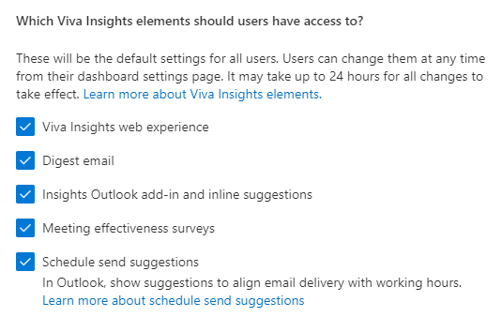
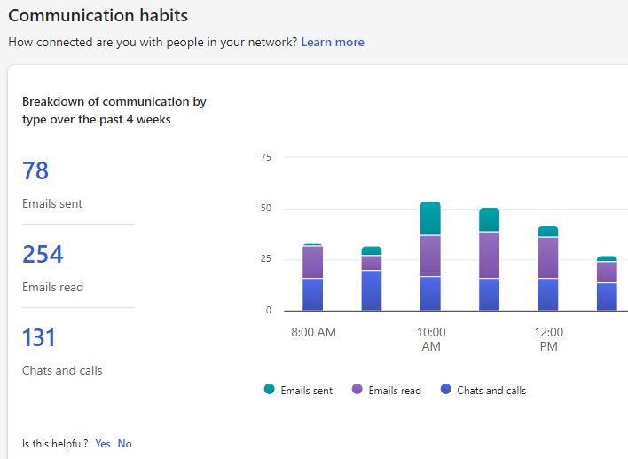
Optional features (non-Copilot): Personal Insights
Microsoft 365 admin
End user (personal insights)
Features are explicitly turned on by Microsoft 365 admin
for those with premium licenses
Available in Outlook and Teams
Can opt-out
Note that this is an optional feature and not required to roll out Copilot Analytics
Learn more about enabling Personal Insights
Notes:
There are a couple of additional features that aren’t essential to turn Copilot Analytics on.
Personal insights are insights about you as an individual. In order to receive this, the Microsoft 365 Admin needs to turn these on.
There are granular controls around what experiences get enabled. This helps you control the roll out and manage communications around it.
Note that individuals can opt-out of this feature. More on this later.
Note: As part of BB1 - March Release, the name of the control will be changed from Viva Insights Web Experience to ‘Personal and Organization Insights’. We will decouple the CDB from this control

Slide 19
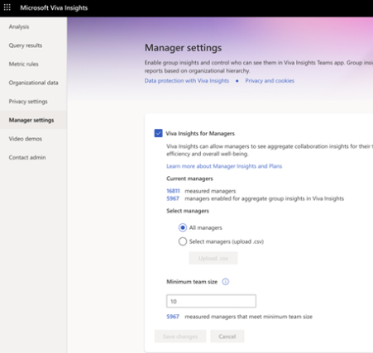
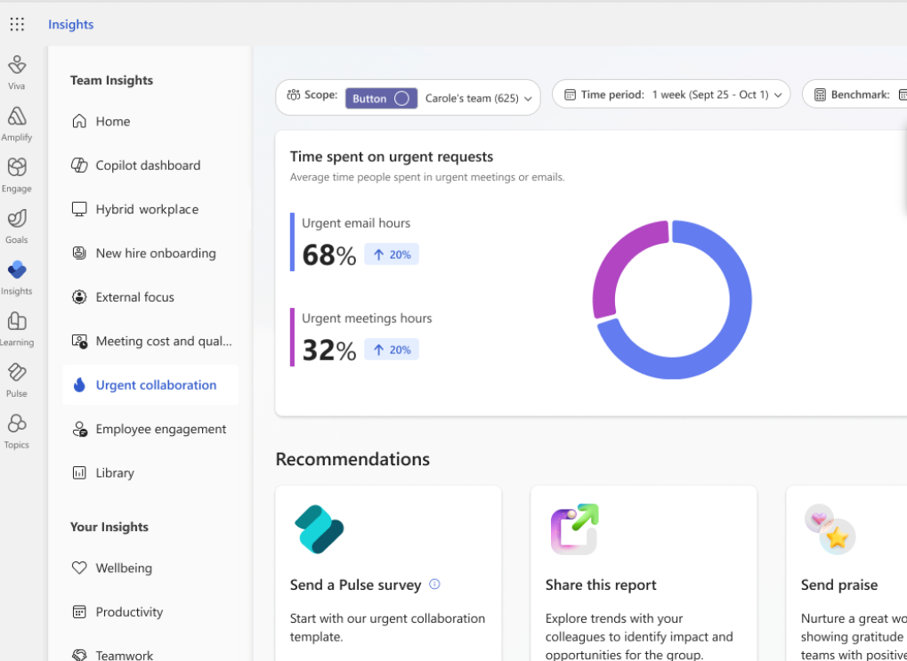
Optional Features (Non-Copilot) : Manager Insights
Viva Insights Admin
Manager (with Org Insights)
Feature explicitly enabled by Viva Insights Admin
for specific Managers
Can be limited to specific regions/orgs
Min team size requirements (5+)
Available in Teams app and web for Managers with
at least 5+ (can be increased) direct reports with premium licenses
Insights about their own team.
Note that this is an optional feature and not required to roll out Copilot Analytics.
Enabling Manager Insights and Manager-specific insights
Notes:
Manager features are made available only when the Insights Admin explicitly turns the feature ON to specific Managers.
Once again, a small number of Managers get access to this. They end up seeing aggregated insights of people in their own team hierarchy.
Although any Manager can be a candidate, only those that have 10 or more in their team see Manager insights.
Revisit this in April: Accurate statement as of Feb 2025. In future, we are adding scoped access to Copilot which will be granted to the GM list.

Slide 20
Scope of analysis – population and feature set
You can control the rollout by experience and population
Licensed population | Considerations
Copilot users only | Understand adoption trends across all Copilot users
Copilot users – exclusion list | Study the adoption trends and impact of a select group of people using Copilot
Experiences | Considerations
Copilot dashboard only | Typically made available to senior leaders and their delegates. Limitations in lookback period and customizability
Advanced Insights only | Small number of analysts supporting advanced scenarios Customizability of metrics, duration, reporting
Copilot dashboard + Advanced Insights | Recommended pattern
Notes:
Finally, you can control the rollout both in terms of experiences as well as licensed population.
You can turn on Copilot Analytics on all Copilot users. Or you can turn it on for everyone except an exclusion list.
In terms of experiences, you can turn on only Copilot Dashboard, only Advanced Insights, or both.
Note that Copilot Dashboard is default enabled for some very senior leaders but as a Global Admin, you can disable the auto assignment.

Slide 21
Compliance and security
Microsoft 365 shared
responsibility model
Architecture
Code and data boundaries
Compliance

Slide 22
Microsoft 365 shared responsibility model for handling data
Microsoft works to ensure that we are compliant
with industry and international standards
Customers are responsible for ensuring their data
within the Microsoft Cloud is protected in a manner
that is compliant with the standards and regulations imposed on the customer.
It’s your data
Customer as data controller
Transparent operation
Microsoft as data processor
Configure
Use
Built-in
security
Continuous compliance
Privacy
by design
Microsoft product terms+ Data protection agreement
Learn more
Notes:
Given that we are handling sensitive data here, we want to touch upon this shared responsibility model.
You are the controller of the data which means you configure and determine the use of data.
We are the processor of this data and we provide certain assurances such as security, compliance and privacy. All of these are governed under OST and DPA – your existing documentation.
The key point here is that we both have specific responsibilities here.

Slide 23
Copilot Analytics– high level architecture
Customer consent required
Customer authorized input and output channels
Personal Insights
Analyst workbench
Leader & manager
3P/data export
Human Centered
Privacy
Experiences
Personal metrics
Org metrics
Query & API
Compute
Personal insights engine
Aggregated / Advanced Insights
Infra
Security,
Compliance,
Enterprise Data Privacy
Various pipelines
File ingestions
Extraction
Microsoft 365 activities
Customer Info (Org data)
3P activities
Sources
Notes:
This is the high level arch.
We start from the bottom here. Our sources of data are Microsoft 365 activities. These are contextualized with org data that you provide us, and if necessary 3P activities.
These are extracted via various ETL pipelines. We also use file ingestion for customer org data.
To process this data we have two kinds of infra – one a personal insights engine and aggregate insights engine. The first one is about you, and the second one is deidentified information about the org.
These engines enable the computation of metrics – personal metrics, and org metrics and
And finally, these metrics power the various experiences across our properties.
Note that in the compute, infra and ETL layer, our security, compliance, and EDP play a critical role while in the experiences layer, we rely on human centered privacy. It’s the approach of designing privacy mechanisms and systems with the end-user in mind, ensuring that they are easy to use, understand, and enable individuals to effectively protect their sensitive information online.

Slide 24
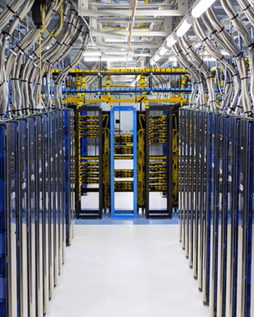
Copilot Analytics – code and data boundaries
Copilot Dashboard | Copilot Power BI Reports (Advanced Insights) | Copilot CSV reports (Advanced Insights)
Aggregated insights | Aggregated insights | Deidentified insights
Compliant boundary for Microsoft 365 ecosystem Azure services that are approved for Microsoft 365 data Data stays within the region
Note for Personal Insights: These are your insights presented only to you. Code runs in the same data center as the mailbox. Data isn’t moved anywhere.
Learn more
Notes:
Personal: Code runs in the same data center as your mailbox. Locality guarantees are ensured. Data isn’t moved anywhere.
Org Insights: azure services that are approved for Microsoft 365 data. Can demonstrate compliance. Makes regional guarantees. Data doesn’t come to US and stays within the region.
Data Residency
Personal insights - Processed and stored in the employee’s Exchange Online mailbox. Data residency is based on the employee's mailbox location.
Manager/Leader/Advanced Insights - The data region for Manager/Leader and Advanced is determined by the Default Geography of the tenant, not individual users.
Data at Rest (header info and metadata sourced from Exchange Online and Teams, but not message content or attachments) is stored in US, EU, EMEA, APAC based on central tenant location.
In case of multi region replication, we default to the primary region.

Slide 25
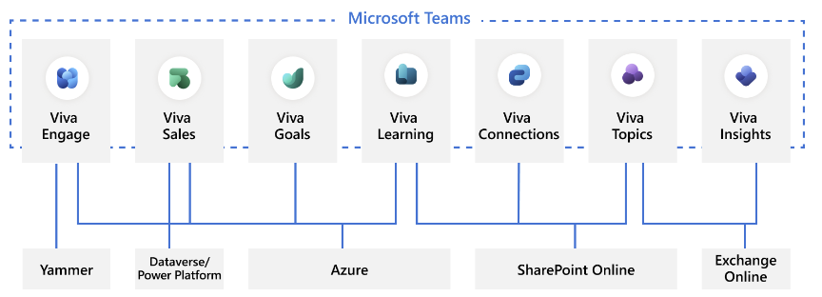
Copilot Analytics – compliance
SSAE 18 SOC 2 Type 2
Copilot Analytics / Viva Insights is covered under SOC 2 Type 2
GDPR
Compliance with EU GDPR
Supports customer initiated Data Subject Requests
ISO 27001/27018
Learn more
Notes:
Lastly from a compliance POV, we are SOC 2 Type 2 compliant.
GDPR compliant.
Support customer initiated Data subject request

Slide 26
Copilot Analytics – data retention and deletion part 1
How long is data retained?
For active tenants, Copilot Analytics initially collects, processes, and retains 13 months worth of data. Then, through weekly refreshes, Copilot Analytics increases this history until 27 months' worth of data is collected. After this point, older collaboration data is deleted as newer collaboration data is collected.
Microsoft will retain Customer Data that remains stored in Online Services in a limited function account for 90 days after expiration or termination of Customer’s subscription so that Customer may extract the data. Customers can download the data in the form of query results during this period. After the 90-day retention period ends, Microsoft will disable Customer’s account and delete the Customer Data and Personal Data stored in Online Services within an additional 90 days, unless authorized under this DPA to retain such data.
Copilot business outcome report capability is limited to the past 6 months.
What happens to data after license is disabled?
If the Copilot Analytics license is removed from a user, Copilot Analytics retains that user's collaboration data that was collected during the period the license was assigned. However, for a user to appear in query results, that user needs to have a license at the time the query is run. Learn more about when users show up in query results.
The person's collaboration data will be deleted according to the overall retention policy described in Data retention for active tenants.
How can a user’s data be permanently removed?
To permanently remove data from users after licenses are removed, you can contact Microsoft customer support to request a collaboration data reset.
Learn more

Slide 27
Copilot Analytics – data retention and deletion part 2
How does Copilot Analytics handle data subject requests?
As a data processor, Microsoft provides mechanisms for your organization as the data controller to honor data subject rights through controls that are built into Copilot Analytics.
Exclusion | You can exclude an employee’s personal information from being processed simply by not assigning a Copilot Analytics license to that employee.
Access | You have the ability to export the raw data, which may contain personal data. The scope of such information is restricted to what's personally associable and doesn't contain aggregate metrics from which no personal information can be gleaned.
Correction | Viva Insights only performs operations (mostly arithmetic) on data provided to it from other sources, like copilot events, email and meeting data from Microsoft 365 or the organizational data that you upload. This data is not corrected through Viva Insights.
Deletion | Microsoft supports the GDPR Right to erasure. Additionally, if necessary, customers themselves can also delete reports that identify the data subject. Customers can also delete the data subject from any other data (such as organizational data) that they may have provided to Copilot Analytics.
Do you support eDiscovery?
Copilot Analytics performs analytics on data sources that are covered under eDiscovery.
Learn more

Slide 28
Copilot Analytics – encryption
Data encryption
Copilot Analytics encrypts both data at rest and data in transit.
Authentication
Viva and Copilot Analytics use Entra ID to authenticate and authorize users. Customers can also setup Multifactor Authentication as an additional security layer.
Credential management
Copilot Analytics uses Azure Key Vault for managing keys.

Slide 29
Privacy
Privacy principles of Copilot Analytics
Data sources and controls
Data output and controls
Users, use cases and controls

Slide 30
Privacy Principles and Controls
No new personal
information revealed
Personal insights (when enabled) are visible only to the individual
Dashboard viewers always see only aggregated insights
It is mathematically impossible for managers and leaders to identify individual information from aggregates.
Putting the customer in control
Admins decide
  Whose data to include
  Who gets access
  What organizational data to include
  How often to update org data
  What’s the minimum aggregate size
  Can employees opt-out permissions
Individuals decide whether to opt
out from personal insights
*Achieved with differential privacy, which uses statistical techniques to change individual values, while keeping aggregates intact
Notes:
2 main principles we apply
No new information is revealed. Let’s take an example, we might produce an insights that says, you spent 10 hours last week in meetings. Now you could technically go through your calendar and compute this for yourself. So we are just simplifying that process. But we will never show something that says, your friend spent 8 hours in meetings because that breaks our principle.
Managers and Leaders always see aggregate insights.
From these aggregate insights, we will prevent derivation of individual insights.
The second principle is we put the customer in control
You get to choose whose data, who gets access, what other 3p info to bring in, whether you want to opt out etc.

Slide 31

Data Sources – Microsoft 365 metadata and copilot events
Content such as the body of email and calendar is not processed
Examples
Calendar
Metadata from
Microsoft 366
Sender / Receiver
Timestamps
Subject
Outlook
Teams
+
Copilot
Copilot actions
Copilot events
Meta data is refreshed weekly in Viva Insights.
Notes:
Let’s go into the data sources now.

Slide 32
Data sources – organizational data
Customers decide what organizational data is added to Copilot Analytics.
Mandatory fields
Optional fields
Example analysis
Job Title, Level,
Role, HireDate
Do we need to provide additional training to new hires for Copilot?
Role related
EffectiveDate
PersonID
ManagerID
Organization
Department, Function, BU, Cost Center
Are we improving our resolution time in customer support through Copilot?
Group related
Organizational data categories
Are employees in Asia using Copilot to decrease their after hours time?
Region, Country,
City, Building
Location
Engagement Score, Performance, Quota Attainment
Do sellers that use Copilot Chat have a higher quota attainment rate?
Outcomes
Notes:
Viva Insights maps organizational data to the collaboration data from O365.
We have 4 mandatory fields – the data for which the record is applicable, the person id, who is their manager, what’s their org. When you upload, the manager id and person id get deidentified.
Along with mandatory ones, customers can bring optional attribute. This allows for a richer analysis.
Here are some examples and why they are important.

Slide 33
Controls for data sources
Microsoft 365 metadata and org data
User exclusion
Content suppression¹
Org Attributes
Determine which employees
are analyzed
Determine what
content is presented
Determine what attributes
are available for analysis
Microsoft 365 Admins can exclude specific users or users from specific regions/orgs from licenses
End users can opt out of personal and advanced insights via the
opt-out feature
Viva Insights Admins can
suppress subjects that contain specific keywords
ACP, Attorney-client, Sensitive
System excludes meetings:
Marked as Private
24 hours+
Status set to Free, OOO,
Working elsewhere
Viva Insights Admins
decide attributes (example below)
Include region, department
Exclude gender
Split org data into partitions to restrict access to individual analyst
1Learn more
Notes:
For both these sources of data (Microsoft 365 and Org Data), you have the ability to apply certain controls
First, you can decide whose data you want to process.
Microsoft 365 Admins can choose to exclude certain people from license assignment. So their data is never processed
End users too can choose to opt out of personal and advanced insights via the opt-out.
Then you have content suppression. You can suppress certain content such as the ones that have ACP or Sensitive
Org attributes

Slide 34
Data outputs of Copilot Analytics
Aggregated dashboards
Explore in
Teams app
Viva Insights
data outputs
PersonId | Date | Copilot actions taken | Department
46625094 | 7/7/2024 | 4 | HR
9b54a243 | 7/7/2024 | 7 | HR
cacd6727 | 7/7/2024 | 14 | Finance
ecaee5b2 | 7/7/2024 | 0 | IT
1909eda2 | 7/7/2024 | 8 | Finance
b7c75fa2 | 7/7/2024 | 22 | Sales
dd9ef68c | 7/7/2024 | 10 | HR
Query in
Advanced
Insights
CSV output
Note: The PersonId is an encrypted identifier unrelated to EmployeeId
Notes:
There are 2 types of outputs
Aggregated output
Deaggregated CSV output
This is an example of query output. As you can see, the unique identifier is de-identified. The metrics that are provided are aggregated and do not expose the metadata in the system.

Slide 35
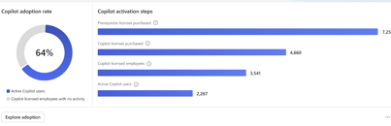
Controls for aggregated dashboard
Controls
Display only aggregates
Individual employees
are never shown
Minimum
N size
Suppresses aggregate results when the number of employees in a group is below the N size
Differential
privacy
Statistical techniques that change individual values while keeping aggregates intact
Aggregated dashboards
Viva Insights admins can decide which Managers get access to Manager Insights
Microsoft 365 admins can decide who
is assigned access to Business Leader
roles for accessing Org Insights
Access
Differential privacy and Distribution masking
Enforced by the system
Determined by the admin
Notes:
There are a number of system enforced controls and also controls that you can enforce.

Slide 36
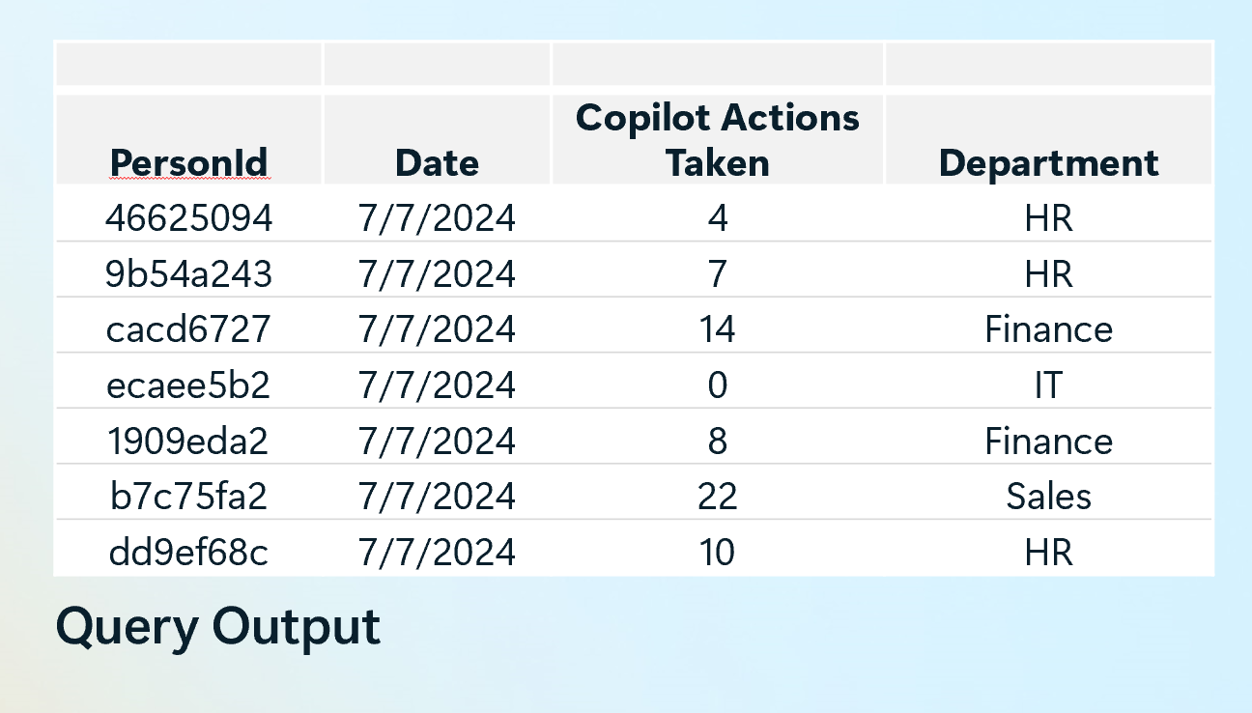
Controls for CSV output
Deidentification
Output is always deidentified
Use partitions to control visibility (example below)
View insights about employees
in North America Sales only
Disable ‘Region’, ‘Role’,
‘Function’ from output
Limit visibility to populations & attributes
Apply suppression on content
Exclude meetings with
specific keywords
Exclude keywords ‘Finance’
Enforced by the system
Determined by the Admin
Notes:
This is an example of query output. As you can see, the unique identifier is de-identified. The metrics that are provided are aggregated and do not expose the metadata in the system.

Slide 37
Controls for users and use cases
Policies are applied by the company. Some examples, below.
Data must be used in employee friendly use cases
Data is not used for legal investigations, compliance, employment purposes
Use cases must be pre-approved by a senior leader
Data always remains deidentified
Access is granted for defined use cases and for a specific duration
Data is not shared / uploaded into 3P sites
Data is presented in aggregates only
These are examples
of policies that the customers may apply

Slide 38
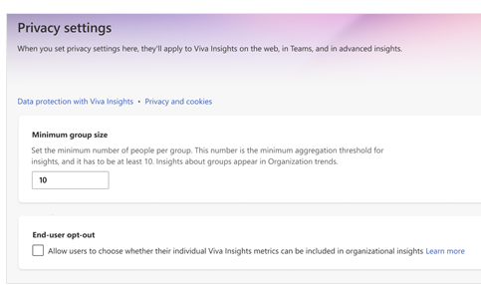
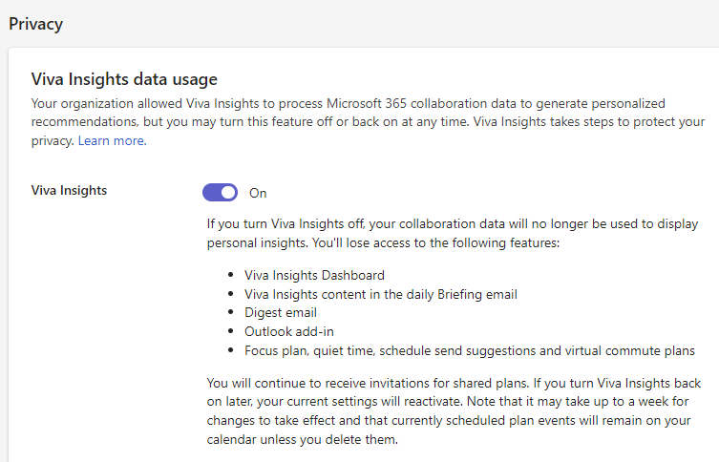
End user opt out
Opt-out can be used to limit data from being part of certain experiences
Viva Insights admin
Individual user
Allows employees the choice to exclude their data from being part of advanced insights
Allows individual to opt out of being
included in advanced insights
Opt-out of personal insights
Allows individual to opt out of
personal insights experiences
Manage opt-out settings in PowerShell
Notes:
Nuanced concept. Companies have different preferences and posture when it comes to opt out. Two steps here: the Viva Insights Admin determines whether individuals get to limit data from appearing in Advanced Insights.
Individuals can then subsequently choose to retain or disable personal insights

Slide 39
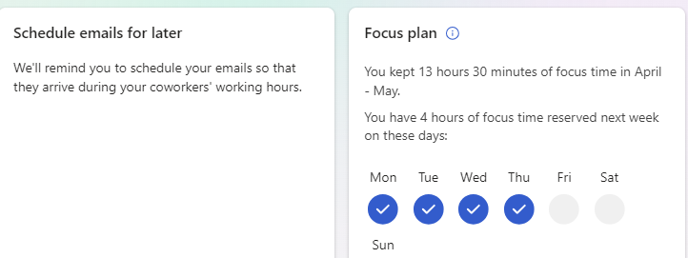
What happens when a user opts out
Excluded
Remains included in
Enabling blanket
opt-out
Personal Insights – features
Copilot Dashboard
If you want to exclude user data from Copilot Analytics, the best way to do so would be by removing them from the Viva Insights service plan in the SKU.
Data in CSV outputs and PowerBI reports (Advanced Insights)
We make it mathematically impossible
to determine individual values
PersonId | Date | Copilot actions taken | Department
46625094 | 7/7/2024 | 4 | HR
9b54a243 | 7/7/2024 | 7 | HR
cacd6727 | 7/7/2024 | 14 | Finance
ecaee5b2 | 7/7/2024 | 0 | IT
1909eda2 | 7/7/2024 | 8 | Finance
b7c75fa2 | 7/7/2024 | 22 | Sales
dd9ef68c | 7/7/2024 | 10 | HR

Slide 40
Works council

Slide 41
Purpose
The purpose of this section is to provide users with a template that can help with Works Council discussion.
For purposes of illustration,
we have provided an example template that explains the scope of the analysis, stakeholders, risks, benefits with sample responses.
Customers are advised to author their own responses that best meets the needs and scope of their use of Viva Insights.

Slide 42
Creating transparency with data use impact assessment
Purpose
Data
Impact
What are we trying
to achieve?
What data will be used?
How will we use it?
Who will be affected
by the analysis?
How will they
be impacted?

Slide 43
Example documentation for Works Council
Notes:
Data use impact
Transparency
Stakeholders,
Benefits and risks
Mitigation

Slide 44
Data use impact
Example content. Users to author their own response.
Category | Example eontent
Summary & business need | Copilot Analytics processes copilot actions and metadata from emails, calendars, chats to compute insights, and presents them in an aggregated and deidentified way. The reports created from Copilot Analytics show trends and insights into working patterns with Copilot. The intention is to adopt a data driven approach to inform how we support our employees with adoption and maximize the value we get from Copilot. There are 2 main experiences with Copilot and 2 optional experiences. Copilot Dashboard: Aggregated insights on Copilot readiness, adoption, and impact presented to enabled users (typically admins and leaders) Advanced Insights: Data analytics workbench to run advanced and custom analysis along with a library of preconfigured reports. Optional experiences: These are additional experiences that can be selectively enabled. They provide insights into overall collaboration patterns. Personal Insights: Helps individuals find opportunities to build better habits and get back in control of their time. Users can only see their own data. Manager and Leader Insights: Provides aggregated insights to Managers with at least 10+ direct reports to help improve team norms and habits, presented in Outlook and Teams app. The scope of this discussion are the main experiences of Copilot Dashboard and Advanced Insights. We recently equipped employees in our marketing division with Microsoft 365 Copilot licenses. Like any new software deployment, there’s a learning and adoption curve. Our goal is to shorten the time to value for this powerful technology, maximizing its benefits for both individuals and the company. Adoption and impact data are central to this transformation, and the Copilot Dashboard, along with Advanced Insights, provides the critical data needed to guide this journey. The analysis will not show insights about individuals, rather groups with a minimum aggregation size of 10 – which can be increased further.
Targeted benefits | Improve our adoption of Copilot Increase the value we are deriving from Copilot
Decisions that will be made | Will be determined post initial analysis. Examples of decisions include offering effective Copilot training, identifying processes that would benefit from Copilot, and defining and assessing our approach for expansion

Slide 45
Transparency
Example content. Users to author their own response.
Category | Example content
Description of the data involved | Microsoft 365 data: Email metadata (sender, receiver, time) Calendar metadata (attendees, duration) Teams collaboration data (sender, receiver, type) Copilot actions (if applicable) | Core organization data: PersonId (deidentified) ManagerId (suppressed from output) Organization EffectiveDate Include others as appropriate
Identifiability and Sensitivity | Can it identify people? The analysis does not identify specific people through the minimum aggregation size settings in Copilot Analytics. We limit organizational data to preclude identification of individuals. The default organizational attributes are Organization, and TimeZone. We restrict use of templatized dashboards to those trained and authorized to handle sensitive personal data. Is the data identifiable to a person or is it de-identified? Data in Copilot Dashboard is always reported in aggregates and protected with differential privacy. All individual data in Advanced Insights is de-identified When reports are published online with Power BI, individual-level data is not made available to any user of these dashboards. Only aggregates are made available. If de-identified, is the process for achieving and maintaining this state described? Only aggregated data is being presented, no individual profiling is possible. Is the data or anticipated use of the data sensitive or likely to be perceived as sensitive? The data presents insights on Copilot usage and overall collaboration. The sensitivity is reduced through aggregation and grouping
Users can enhance this page as needed. Additional details: Advanced insights privacy | Microsoft Learn

Slide 46
Stakeholder, benefits, risks and mitigation
Example content. Users to author their own response.
Stakeholder | Benefits | Risks | Mitigation
Business sponsor (Name the group) | Improved knowledge of Copilot adoption and impact. Identify processes that can benefit from Copilot Understand the impact of Copilot Inform initiatives to accelerate adoption (trainings, promptathons etc.) | Correlation versus causation challenge Incomplete or missing insights if employees are using free or competing products | Adopting a holistic perspective with different sources and feedback on Copilot impact (interviews and survey) Guidance and policies on using a single, enterprise grade company approved tool
Employee | Accelerated learning to Improve productivity Reduce after hours Accessing new information Ability to do things that weren’t possible Ability to acquire new skills Improved change management experience | Concerns about being monitored Sense of overwhelm with new training Pressure to use Copilot even when it doesn’t align with their workflow | Communicate scope of effort and processes that prevent people from being identified Flexibility in rolling out or recommending training content in Copilot Academy, including self-paced ones Engaging in discussions with employees on how Copilot fits with their workflows. Driving awareness around how it improves access to information, saves time

Slide 47
Stakeholder, benefits, risks and mitigation (1)
Example content. Users to author their own response.
Stakeholder | Benefits | Risks | Mitigation
Works Council | Enhanced transparency can help ensure the roll out of Copilot is aligned with employee needs and expectations Advocate for professional development based on learning gaps Create a supportive working environment that ensure equitable access to new tech Improved understanding of how Copilot is changing work and how it is impacting employee experience | General uncertainty of new technologies or data Employee awareness on scope of analytics Misconceptions about the use of such data Data accuracy –e.g., low usage might be due to technical issues as opposed to employee resistance Create a precedence for collecting employee data | Transparency on product features, and intended use Clear communication to employees on what data is analyzed and how the tool and the company does not support surveillance Clarity on use cases and articulation of any KPIs that might be used to assess impact. Assurances from leaders that performance monitoring is not an approved use Gathering feedback from surveys and interviews alongside usage on Copilot experience to understand tech or other issues affecting Copilot Scoping the data collection to a defined duration and specific outcome (e.g., attaining a 50% daily active usage)
HR | Aligns with HR programs to improve employee experience, skilling, and training. Demonstrate commitment to act on employee feedback. | Perception of surveillance Lack of context around adoption Employee concerns around actions that may follow the analysis | Communicating scope of effort and processes that prevent people from being identified. Collaboration with Works Council to articulate a data use policy. Combining usage data with surveys and interviews provides additional context Applying the data only towards scoped and approved effort prevents misuse

Slide 48
Stakeholder, benefits, risks and mitigation (3)
Example content. Users to author their own response.
Stakeholder | Benefits | Risks | Mitigation
Legal | To be written by the company | Approving a technology or use case that can expose them to misuse or legal challenges from employees Collecting data that might be deemed beyond necessary for business operations | Transparent communication with the employees on efforts and guardrails in place to prevent identification Agreement on scope and use of data can prevent misapplication
Analyst | Delivery of business-critical insights and analysis Opportunities to play an important role in transforming the organization | Reputational risks from surfacing incorrect or misleading insights Incorrect handling of sensitive data | Scoping analyst use specific, verified, error-free ‘queries’ Limiting capabilities and data available to analyst

Slide 49
Resources

Slide 50
Helpful documentation
Introduction to advanced insights
Enabling manager insights
Learn more about enabling personal insights
Microsoft 365 Copilot Dashboard
Microsoft 365 shared responsibility model for handling data
Where your Microsoft 365 customer data is stored
Data residency for Advanced Insights, managers, and leaders
Compliance with EU GDPR
Data retention for active tenants
Advanced Insights – data retention and deletion
Manage settings for the Copilot Dashboard
Policies for Copilot in Viva

