Slide 1
Microsoft AI Tour

Slide 2
Leveraging AI for Infrastructure Management
Rick Claus
Principal Cloud Advocate Team Lead
Bluesky: 🦋 @RegularITguy.com

Slide 3

Everyday you need to do more
Put in presentation mode to see video
Joe and Lance are working on a procedural art (programmatic) background video showing exponential growth/challenge.
We’ll have a long list of examples that scroll up the page.
More Users
More Needs
More Workloads
More Requirements
More Services
More Capabilities
More Middleware
More Platforms
More Solutions
More DevOps
More Clouds
More Environments
Notes:
Everyday you need to do more
Users => Needs => Workloads => Requirements => Services
Each w/ more capability => middleware => solutions => Platforms => devops => clouds => environments
Exponential challenge

Slide 4
You need to do more, and you need it…
Correct
Compliant
Safe
Performant
Yesterday
Repeatable
Cost effective
Notes:
Next slide → question we ask and answer from customers

Slide 5


The primary benefits of AI for operators
Automate cognitive tasks
Faster access to information
Notes:
AI isn’t’ the first thing that’s helped us with Cognitive tasls: Scripting or programming languages to automate
Processing sheer loads of information to provide solutions. BUT – “sort of trust, but verify”
Are we going to be replaced? (no)
story

Slide 6
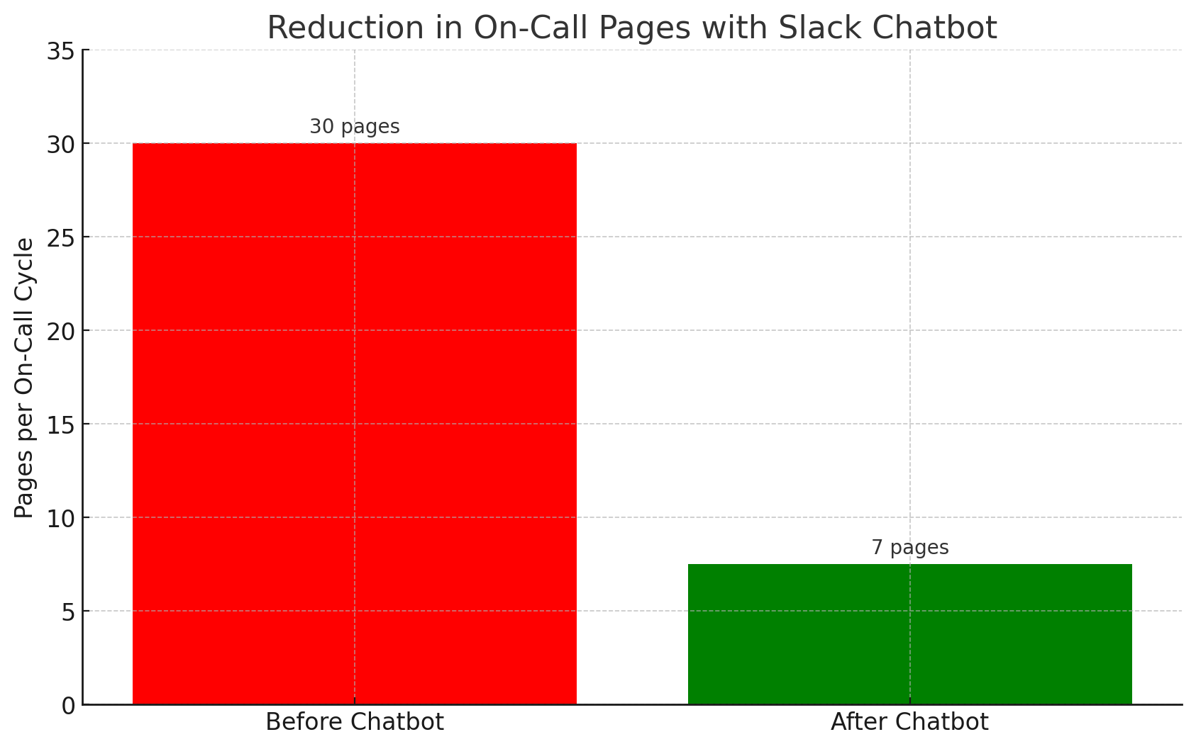
Customer story: reducing on-call fatigue with a Chatbot
Problem
Outcome
Extreme On-Call Fatigue
30 pages per on-call cycle (1 weeklong)
80% of pages were mundane
Solution
Slack Chatbot
Empowers developers to perform tasks themselves
Handles common, repetitive tasks
~75% reduction in pages per on-call cycle
Notes:
Imaging being on call, paged 3 times a night for mundane things (disk space, restart server, failed build). You get call because you have access to do things and you know things.
2016 – chatbots were the rage – team implemented one to fix things
Automation in slack with powershell in background to automate these mundane tasks
Dedicated team of engineers to program logic and verification of tasks
Resultant savings

Slide 7




Costs of maintaining a Chatbot
Scalability
Time Investment
Security Concerns
Notes:
Scaleability – how does it grow and new scenarios/solutions?
Time- cleaning up old solutions, building new ones, testing
Security – automation hitting your production environment. Have you red teamed it? RBAC?

Slide 8


Managing IT infrastructure with copilots
Microsoft
Copilot in Azure
GitHub
Copilot
AI Shell
Preview
Preview
Notes:
Why LLMs and Copilot?
Large training base for knowledge
Tuned to your environment
Controlled by governance and RBAC
Where you need it

Slide 9
Demo
Learning about an azure service
Understanding deployment options
Deploying a workload to Azure
Getting information from existing resources

Slide 10
Managing existing infrastructure by leveraging AI
Notes:
Learning about a new service and deploying it…
What about existing? How does Copilot in azure help us?

Slide 11



Microsoft Copilot in Azure
Design
Operate
Optimize
Troubleshoot

Slide 12



Microsoft Copilot in Azure
Design
Operate
Optimize
Troubleshoot
Portal
Mobile App
Command Line Interface (CLI)

Slide 13
Microsoft Copilot in Azure
Tooling
API
SDK
CLI
PowerShell
Azure Portal
Data sources
Cost
Documentation
Logging
Monitoring
Governance
Policy
RBAC
Tags
Azure Resource Model & Graph
Services
Infrastructure
Notes:
Let’s talk a little bit about how this is put together
Tooling it has access to, data it can tap into governance (as you RBAC)

Slide 14

Microsoft Copilot in Azure
Tooling
API
SDK
CLI
PowerShell
Azure Portal
Copilot LLM
Data sources
Cost
Documentation
Logging
Monitoring
Governance
Policy
RBAC
Tags
Azure Resource Model & Graph
Services
Infrastructure
Notes:
So, we take all that knowledge, and using large language models, are able to
understand the intent of what’s being discussed, understand the context (where in portal, what resources, etc)
We take that intent and that context to construct a plan to answer that question, across those data sources.
Next

Slide 15
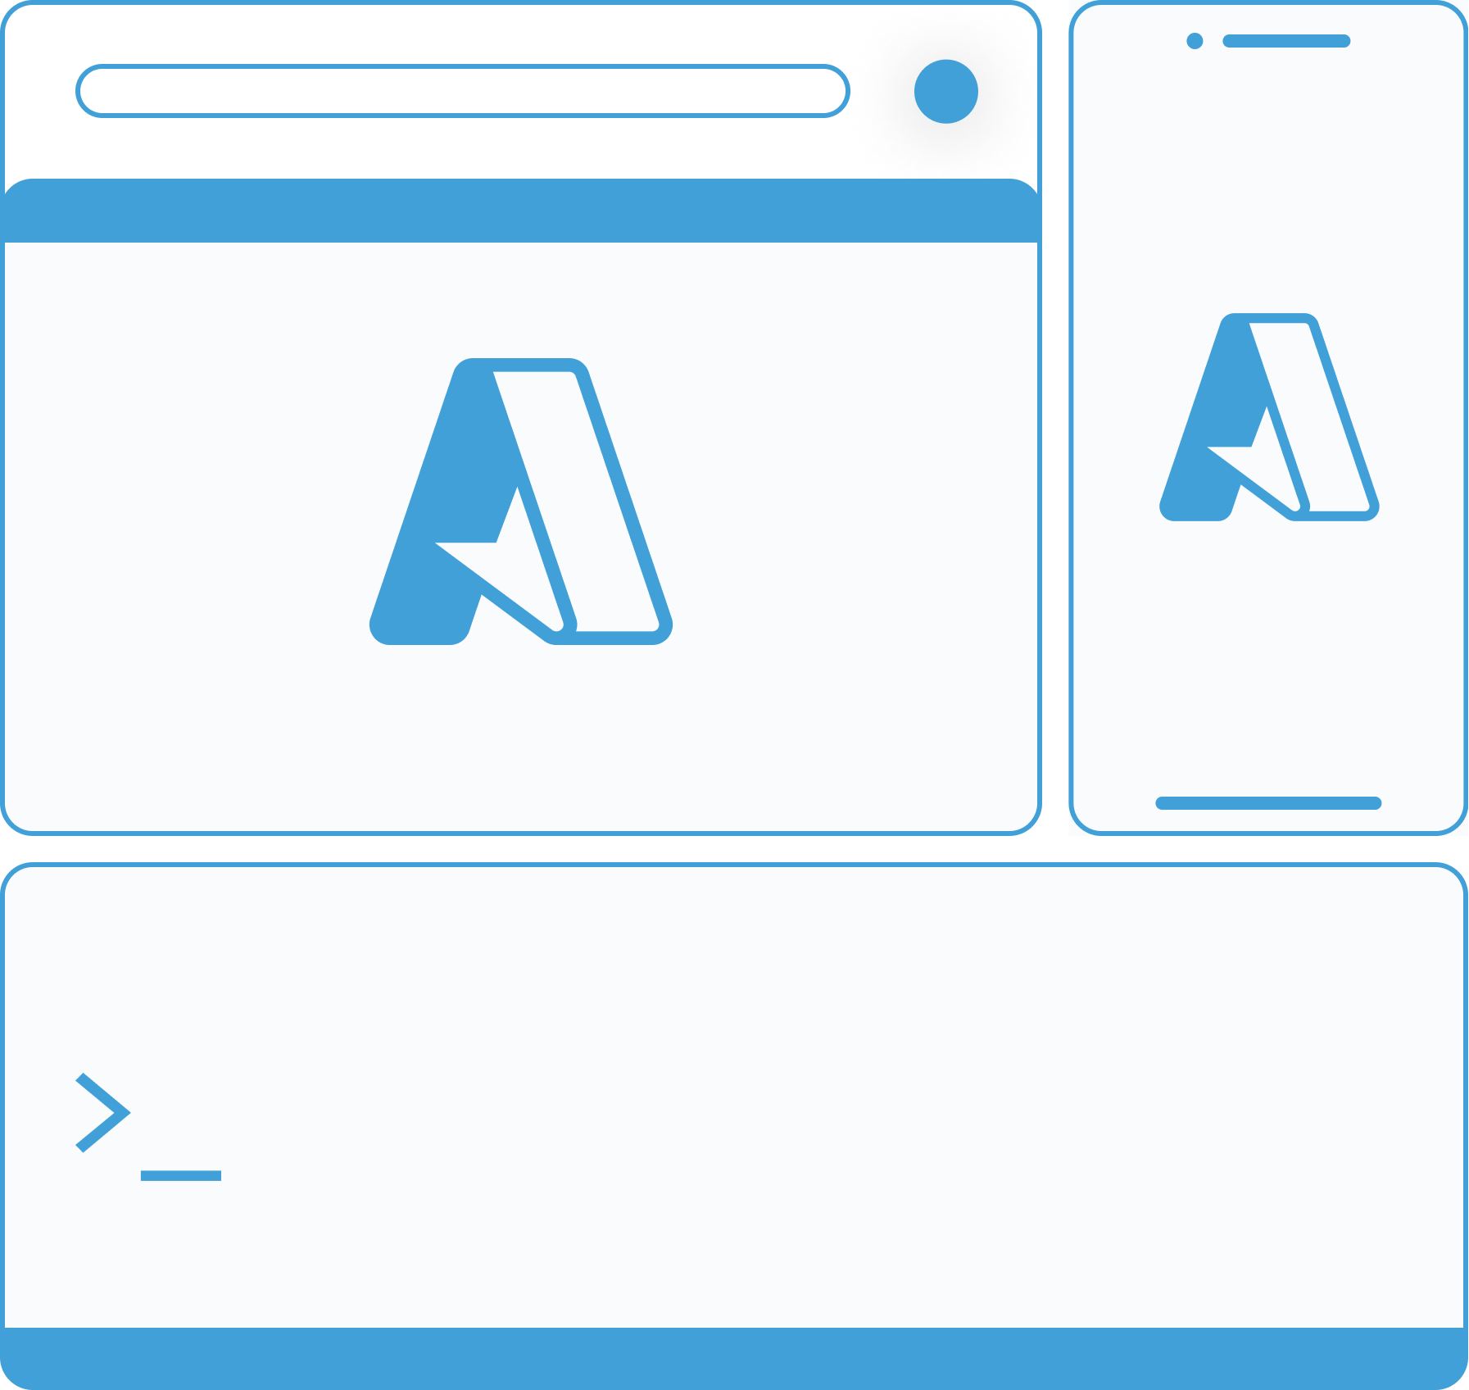



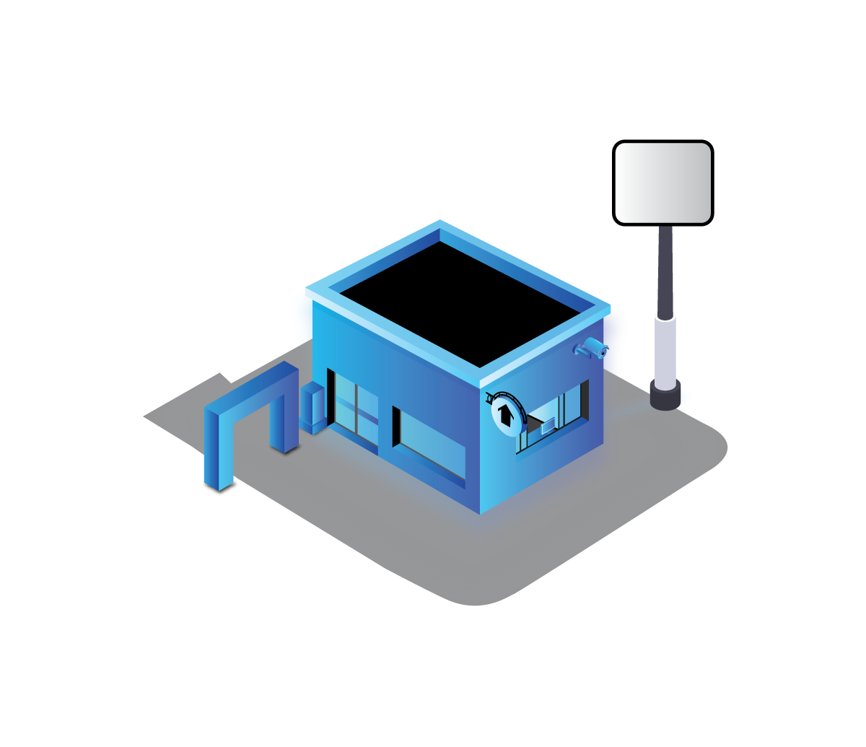


Microsoft Copilot in Azure
Tooling
API
SDK
CLI
PowerShell
Azure Portal
Copilot LLM
Arc and Edge
Data sources
Cost
Documentation
Logging
Monitoring
Governance
Policy
RBAC
Tags
Azure Resource Model & Graph
Services
Infrastructure
Notes:
EDGE => additionally, any edge device, or telemetry from those, that’s connected via Arc can surface knowledge and data
We then execute that plan, acting on behalf of the user <= important point.
If that plan has side effects (“reboot the VM”), we’ll always present a confirmation to the user
Copilot automatically inherits your organization’s security, compliance, and privacy policies for Azure. Data is managed in line with our current commitments. Copilot large language models are not trained on your tenant data.
Copilot can only access data from Azure and perform actions against Azure when the current user has permission via role-based access control.
All requests to Azure Resource Manager and other APIs are made on behalf of the user.
Copilot does not have its own identity from a security perspective. When a user asks, ‘How many VMs do I have?’ the answer will be the same as if they went to Resource Graph Explorer and wrote / executed that query on their own.
Microsoft’s work on AI is reviewed for potential harms and mitigations by a multidisciplinary team of researchers, engineers, and policy experts. All of the features in Copilot are carried out within the Azure framework of safeguarding our customers’ data security and privacy.

Slide 16
Data flow
Copilot frontend
Azure Portal (Host)
1
Get context
Extensions
Shell context data
Current view data
Context & Action services
Adaptive cards
Chart
Code block control
6
Render rich visuals, ask for confirmation
Chat UX
Portal views
Prompt (context + question)
Response
7
Access data under user context
2
5
Orchestration
3
Call plugins
Grounding
Prompt & response
filtering (Responsible AI)
Plugin store
Plugins
Docs & learn
KQL Query
ARM
4
Access data under user context
AI Infrastructure
Cost
. . .
Notes:
Let’s talk a little bit about how this is put together
First, let’s look at the logical layers that we build the portal and other tooling on top of
And, let’s think about there being a lot of knowledge in each of these that we’ll build on top

Slide 17
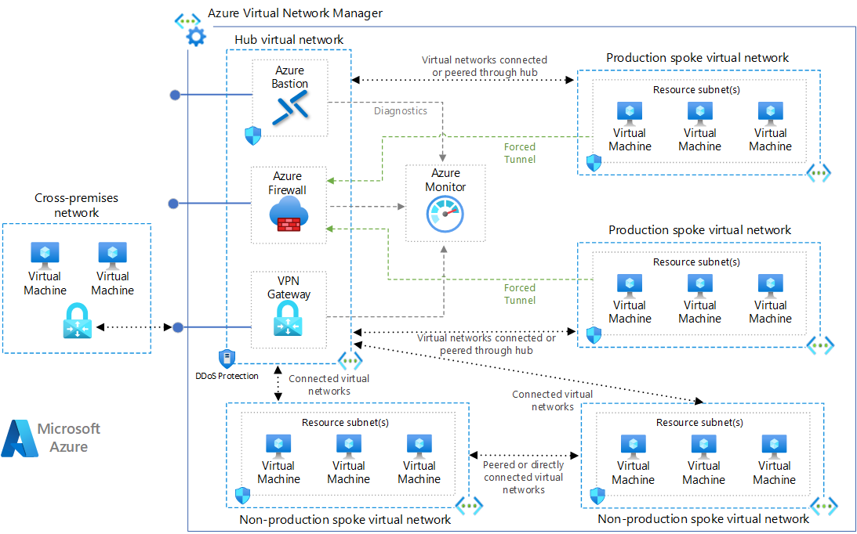
Managing existing infrastructure with AI
Get status and health
of your environment
Monitor events and metrics
across your enterprise footprint
Resilience and maintenance
In cloud or on-prem, same results
UI or shell, your choice
Notes:
Check Azure service health and impacts on your resources
Help with errors in Notification pane
Help with forms
Troubleshooting security and performance

Slide 18
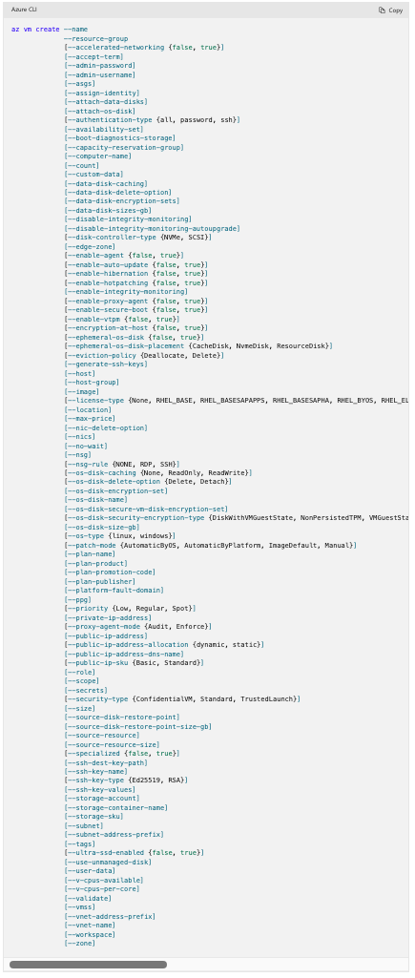
Observations
The Shell can be intimidating…
Exponential growth of command due to cloud
  Azure PowerShell: 6,000+ cmdlets
  Azure CLI: 10,000+ commands
  Microsoft Graph: 50,000+ cmdlets
Tab completion is not always useful / helpful
  Parameters require complex objects
  Too many commands with the same beginning
Combinations of parameters too complex
  Optional vs required parameters
  Difficult to identify value types
Notes:
There are 102 parameters for AZ VM Create

Slide 19
Observations
The Shell can be intimidating…
Exponential growth of command due to cloud
  Azure PowerShell: 6,000+ cmdlets
  Azure CLI: 10,000+ commands
  Microsoft Graph: 50,000+ cmdlets
Tab completion is not always useful / helpful
  Parameters require complex objects
  Too many commands with the same beginning
Combinations of parameters too complex
  Optional vs required parameters
  Difficult to identify value types
Notes:
There are 102 parameters for AZ VM Create

Slide 20
Demo
Manage access to Microsoft Copilot in Azure
Check Overall Service Health and Impact
Troubleshooting error messages
WebApp AI Powered Diagnostics & Proactive Monitoring
Hybrid Connected Resources
AI Shell

Slide 21
Demo
Manage access to Microsoft Copilot in Azure
Check Overall Service Health and Impact
Troubleshooting error messages
WebApp AI Powered Diagnostics & Proactive Monitoring
Hybrid Connected Resources
AI Shell

Slide 22
Demo
Manage access to Microsoft Copilot in Azure
Check Overall Service Health and Impact
Troubleshooting error messages
WebApp AI Powered Diagnostics & Proactive Monitoring
Hybrid Connected Resources
AI Shell

Slide 23
Demo
Manage access to Microsoft Copilot in Azure
Check Overall Service Health and Impact
Troubleshooting error messages
WebApp AI Powered Diagnostics & Proactive Monitoring
Hybrid Connected Resources
AI Shell

Slide 24
Demo
Manage access to Microsoft Copilot in Azure
Check Overall Service Health and Impact
Troubleshooting error messages
WebApp AI Powered Diagnostics & Proactive Monitoring
Hybrid Connected Resources
AI Shell

Slide 25
Demo
Manage access to Microsoft Copilot in Azure
Check Overall Service Health and Impact
Troubleshooting error messages
WebApp AI Powered Diagnostics & Proactive Monitoring
Hybrid Connected Resources
AI Shell

Slide 26
Resources & Links
https://docs.github.com/copilot
https://azure.microsoft.com/products/copilot
https://learn.microsoft.com/en-us/azure/copilot/responsible-ai-faq
Manage access to Microsoft Copilot in Azure | Microsoft Learn
Work smarter with your Azure Stack HCI clusters using Microsoft Copilot in Azure | Microsoft Learn

